Slide 1
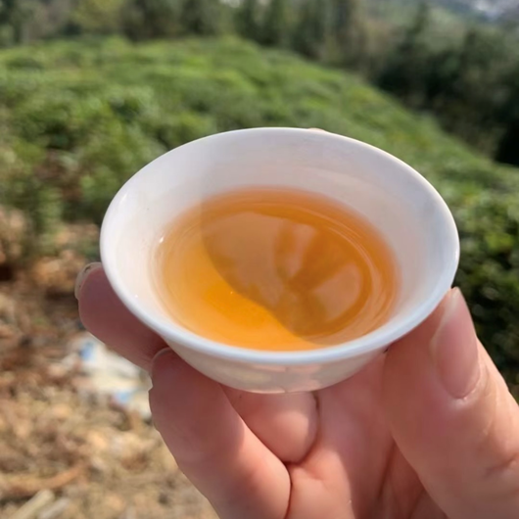
Fenghuang Dancong Oolong
Presented by
New York Tea Society

Slide 2
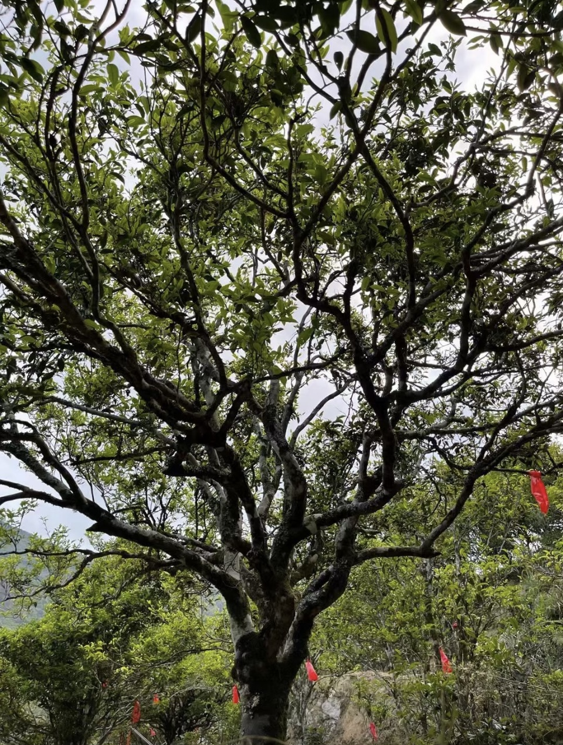
What is Dancong Tea?
Dan Cong (单枞) is an oolong tea
It is produced in Fenghuang Shan (Phoenix Mountain) in Guandong Province, China
The origins of Dan Cong oolong can be traced to the last stages of the Song Dynasty (960-1279).
Fenghuang Shan’s highest point is Niaoji Shan at 1560m
Wudong Shan (1391m) is the main Dancong production region.
Dancong literally translates to "single bush".
Originally, the mother tree of Dancong is the Shuixian tree.
This tree grew in the wild where locals would pick them to produce tea.
Because the trees were growing from seed, they developed different characteristics.
The locals soon noticed that each tree produced tea with special unique flavor profiles.
They took grafts from the ones they especially liked and cultivated them individually.
Over time, this isolated cultivation led to the flavors and fragrances in each variety becoming more pronounced.
New varieties are still being discovered today.

Slide 3
Dancong Classification
Cultivars
All Dan Cong teas are made using tea leaves from the ‘Shui Xian’ cultivar
However, there are hundreds of sub-cultivars developed after many generations of farming
Classification by Tea Bush Shape
Qiao Mu / Da Cong (Large Bush Arbor Tea): the tree is tall, large, and flourishing.
Wang Tian Tea (Looking Up Tea): the height of the plant is around 8 meters
Tuan Shu (Circle Tree): the tree branches grow out like a big round circle.
Chicken Cage: the tree looks like a cage for chickens in a farmhouse.
Girl with Umbrella: the tree resembles girl holding a green umbrella
Large Grass Shed: the tree grows like a shed that the farmer uses to stock grass for the cattle. Leaf Shape
grapefruit leaves (You Ye)
persimmon leaves (Shi Ye)
bayberry leaves (Yang Mei Ye)
Leaf Color
‘Bai Ye’ (‘White Leaves’, actually light green or yellow green)
‘Wu Ye’ (‘Dark Leaves’, the actual leaf color is dark green).
Leaf Size
‘Da Wu Ye’ (Big Dark Leaves)
‘Wu Ye Zi’ (Baby Dark Leaves)
‘Da Bai Ye’ (Big White Leaves)
‘Bai Ye Zi’ (Baby White Leaves) Appearance of Dry Tea Leaves
‘Da Gu Gang’ (Big Bone Red)
‘Da Hu Qi ‘(shape like a leech with small ends)
‘Si Xian Cha’ (Silk Tea)
Noodle Tea
Glue Paper Wings (like the wings of a dragonfly, opened and thin).
Location/Origin
‘Wudong’ Dan Cong
‘Shitou’ Huang Zhi Xiang
‘Zhongping’ Zhi Lan
‘Chengtou’ Zhi Lan
Historical Events, Stories, Legends
‘Dong Fang Hong’ (Oriental Red) refers to the Cultural Revolution period.
‘Zong Suo Xie’ refers to a specific Dan Cong legend.
‘Ba Xian Guo Hai’ (Eight immortals crossing the sea)
'Ya Shi Xiang' (Duck shit tea)
'Lao Xian Weng' (Old Fairy) Classification by Tea Aroma
Huang Zhi Xiang: yellow gardenia aroma
Zhi Lan Xiang: orchid aroma
Gui Hua Xiang: osmanthus aroma
Xing Ren Xiang: almond fragrance.
Mi Lan Xian: honey-orchid aroma (taste like sweet potato to some people)
Ye Lai Xiang: tuberose aroma
Jiang Hua Xiang: ginger flower aroma fragrance
aka "Tong Tian Xiang", aroma from the sky.)
Rou Gui Xiang: cinnamon aroma
Mo Li Xiang: jasmine aroma
Yu Lan Xiang: magnolia aroma

Slide 4
Single Bush?
Dancong translates to ‘Single Bush’
The name dancong dates to the communal farming era
Dancong was the highest grade, harvested from larger, older trees, which have been individually picked, processed, and then blended.
Fenghuang Oolong gained fame due to the popularity of dancong style tea
With time, all tea produced in Fenghuang Shan began to be known as Dancong Oolong
Today, most dancong is produced from single varietal tea groves propagated from the same mother tree to produce a consistent and unique flavor.
Single tree tea can be found, known as Dan Zhu (Single Tree)
Dan Zhu is produced from tea leaf material harvested from a single tree

Slide 5
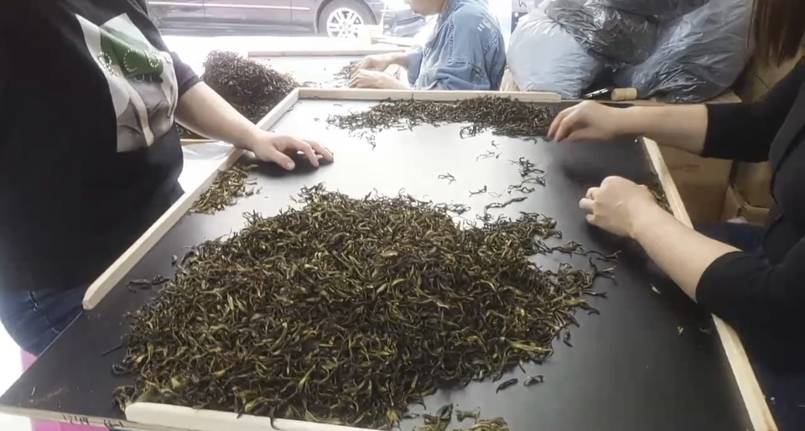
Processing Dancong
Picking
Oolong uses leaves only, no buds. Dan Cong picks the youngest leaves when the bud has just fully opened up
Wilting
The freshly picked leaves are allowed to wilt from 15 minutes to 2-3 hours, dependent on the weather.
Once the leaves are silky and soft, they are moved inside to continue to wilt under shade
Shaking/Tumbling
This is the signature step to making oolong
Traditionally, shaking was done on a bamboo tray but is now done in a tumbling machine.
Resting
The tea leaves are then spread out on bamboo trays and allowed to rest for several hours while they begin to oxidize, forming red edges on the leaves
Fixation
The leaves are now heated in a wok to kill the enzymes and halt oxidation
Rolling
The hot teas are then transferred to a rolling machine to be rolled into string shapes
Baking
The leaves are again spread out on bamboo trays to dry out by baking over electric or charcoal heat
Sorting
Stems and leaves are removed from the rough tea
Roasting
Then sorted tea is charcoal roasted for 6-10 hours.
This step may be repeated several times with a resting time of approximately 3 weeks in between each roasting.

