Slide 1
Discovering Yunnan
New York Tea Society
Educational Series

Slide 2
Yunnan – Course Overview
Lesson 1:
The Land…
The People…
The Tea
Lesson 2:
The OLD Famous Tea Mountains
Lesson 3:
The NEW Famous Tea Mountains
Lesson 4:
Other Notable Tea Regions Of Yunnan

Slide 3
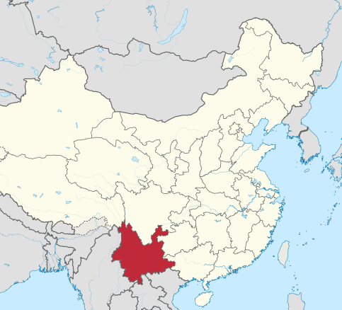
Geography
Yunnan is bounded by;
Tibet to the northwest
The province of Sichuan to the north
The province of Guizhou to the east
The province of Guanxi to the southeast
Laos and Vietnam to the south/southeast
Myanmar (Burma)to the southwest/west
Yunnan literally means “Cloud South
its geographical location which is south ofthe Yun(Ling) mountain range.
The capital of Yunnan is Kunming.

Slide 4
Elevation
Yunnan is situated in a mountainous area, with its highest elevation in the northwest (6,740 m/ 22,110 ft), and its lowest elevations in the southeast.
Most of the population lives in the eastern part of the province.
In the west, the altitude can vary from the mountain peaks to river valleys by as much as 3,000 metres (9,800 ft).

Slide 5
Climate
Eastern Plateau Region
Because of the high elevation, summers are cool, winters are mild.
June–July temp average 71 °F (22 °C),
Dec–Jan temp average 48 °F (9 °C).
Annual growing season of 10 months.
Western Canyon Region
High mountains and deep valleys create vertical climatic zones.
Sultry heat with high humidity dominates the bottom of the valleys,
A temperate zone prevails at 6,000 to 11,000 feet (1,830 to 3,350 metres)
Freezing winds envelop the tops of the mountains.
Yunnan, under the influence of rain-bearing monsoon winds blowing from both the Pacific and Indian oceans, enjoys good precipitation (nearly all of it as rainfall).
The bulk of the rain falls from May through October,
The rain is heavier in the western canyon region than in the eastern plateau region.
Average annual rainfall in Kunming is about 49”

Slide 6
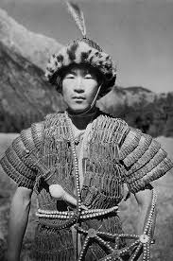
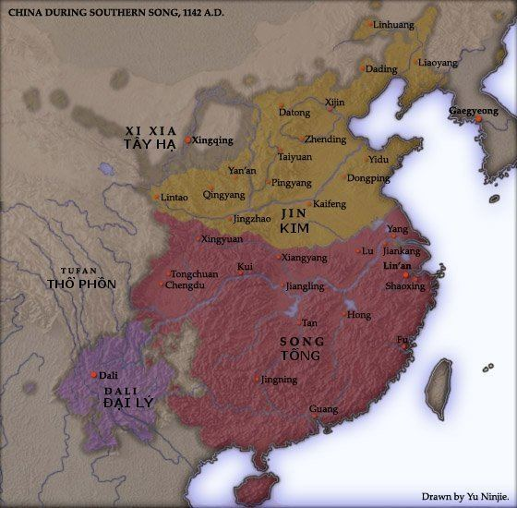
Historical
Background
The area, known today as Yunnan, was inhabited by indigenous groups beyond the reach of Han Chinese civilization, although Chinese suzerainty was acknowledged under the Qin (221 BC–207 BC) & Han dynasties.
The Yizhou prefecture was set up by the Han in 109 BC.
Under the Tang dynasty (618–907), a Dai kingdom known as Nanzhao, flourished in the Dali region.
Nanzhou was 1st sanctioned as a bulwark against Tibeten incursions
Nanzhao eventually threatened Chinese power, which declined during the Five Dynasties Period (907–960) and the Song Dynasty (960–1279).
This situation came to an end during the Yuan Dynasty (1206–1368).
The Mongols destroyed Nanzhao in 1253, and named the area Yunnan, they made it a province of Yuan China in 1276.
To resettle Yunnan, which had been depopulated by warfare, the governor brought in large numbers of Hui (Chinese Muslims) from northwestern China.
The Mongol conquest drew Yunnan into the orbit of Chinese affairs but failed to reduce local interethnic tension between Han and non-Han minorities.
Rulers of the Ming dynasty (1368–1644), seeking to tighten their control over the province, used military units to promote migration of the Chinese people from the Yangtze River valley to Yunnan.
During this time, Yunnan was governed through a system of hereditary tusi—that is, local leaders serving as agents of the Chinese magistrates.
This policy of indirect rule was continued under the Qing Dynasty (1644–1911) & the Republic (1911–49)
From the Yuan dynasty onward, the area was part of a central-government sponsored population movement towards the southwestern frontier, with two major waves of migrants arriving from Han-majority areas in northern and southeast China.
As with other parts of China's southwest, Japanese occupation in the north during World War II forced another migration of Han people into the region. These two waves of migration contributed to Yunnan being one of the most ethnically diverse provinces of China, with ethnic minorities accounting for about 34 percent of its total population.

Slide 7
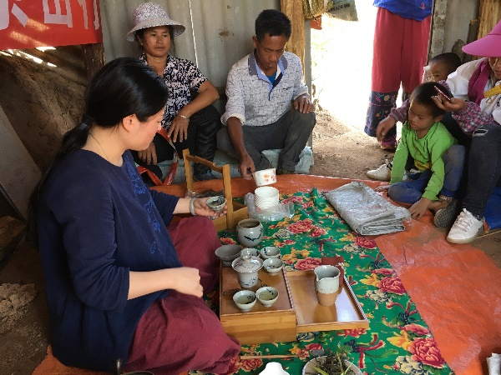
Demographics
Yunnan is the province with the largest population of minorities, with 25 of them having more than 5000 members
Among them 16 are indigenous (including Bai, Dai, Naxi, Hani, Lisu, Lahu, Wa, Jingpo, Bulang, Pumi, Achang, Nu, Jinuo, De’ang, Durung, etc.).
Among the 25 ethnic minority groups, the biggest population is Yi and the smallest one is Dulong
The ethnic minorities spread around Yunnan with their own communities and live together over vast areas while some live in individual concentrated communities in small areas.
Due to different groups, the traditional customs, cultures, languages, construction styles and clothes are colorful and distinctive.

Slide 8
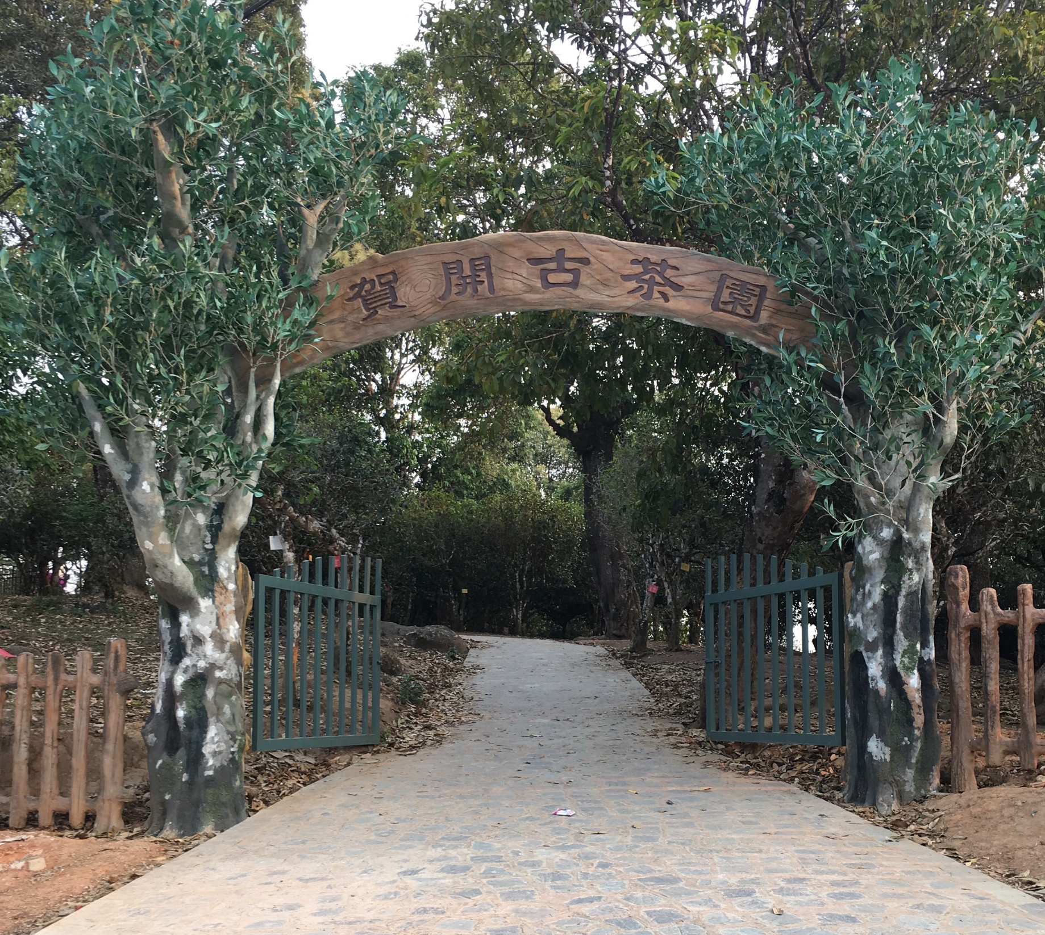
The Teas of Yunnan
Green Tea
Dian Hong
Yue Bai Guang
Pu’er
Sheng
Shou

Slide 9
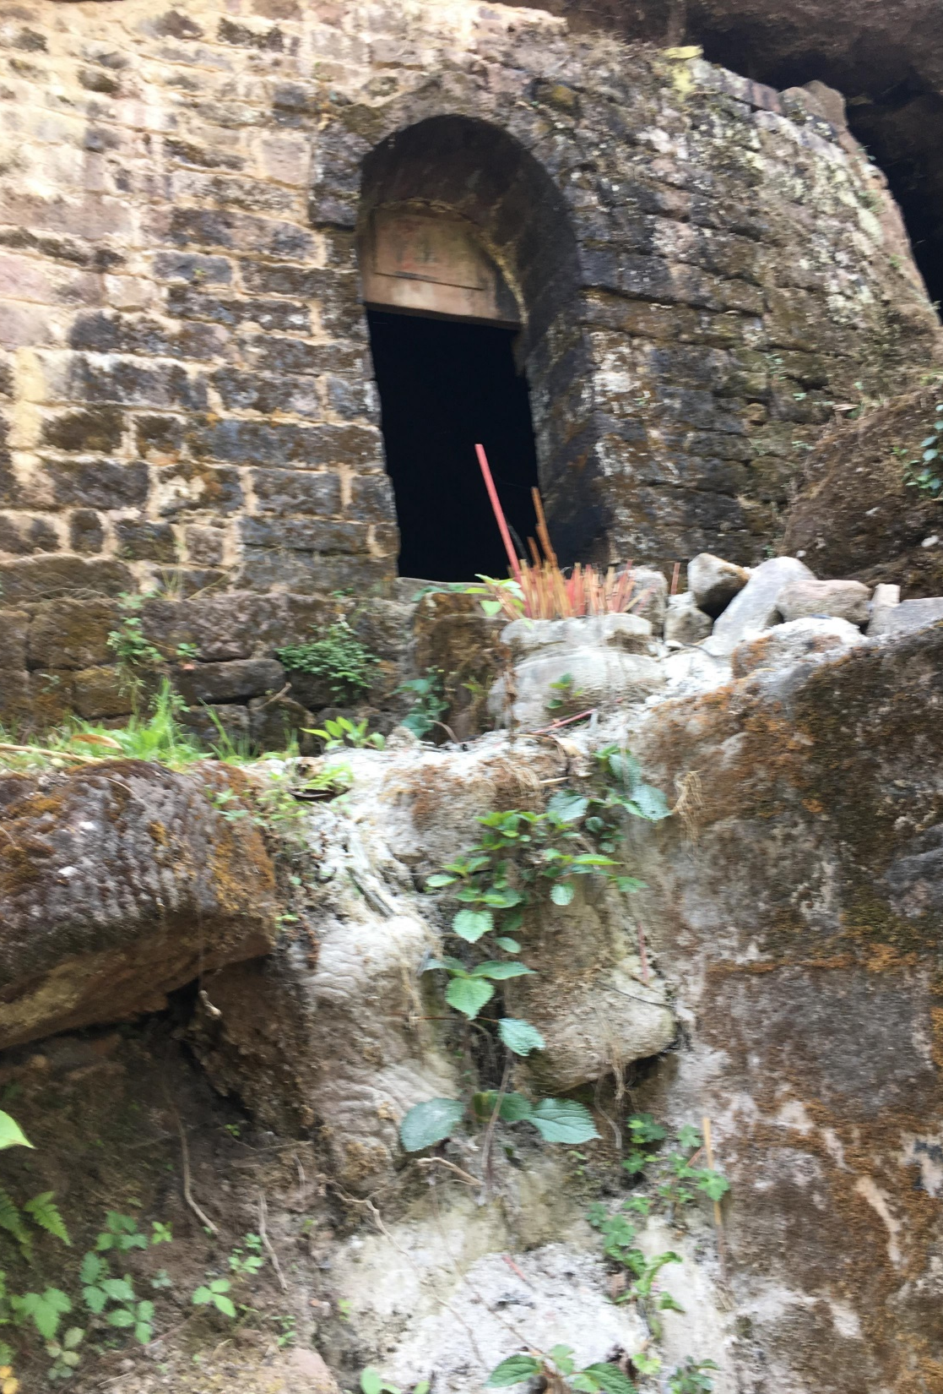
Yunnan Tea History
The ethnic Pu people in Yunnan began to grow tea and served it as tribute to the emperors as early as in the Chinese Shang and Zhou Dynasties.
In the West and East Han Dynasties, tea was grown in river valleys and by the mountain trails of Yizhou.
In the Three Kingdoms Period, The Nanzhong tea-seed was widely popularized.
In the Tang Dynasty, tea produced in Xishuanbanna was marketed to Dali area and became the favorite drink of the noblemen of the Nanzhao Kingdom.
In the Song Dynasty, Pu’er County became a famous market for trading tea and horses.
In the Yuan Dynasty, tea had become the most important commodity in the transactions undertaken by people of all ethnic groups.
In the former part of the Qing Dynasty, the reputation of Pu’er tea reached its climax. The years starting in 1926 and ending in 1936 which were on the eve of the War of Resistance Against Japan marked the most prosperous period of production and sales of Yunnan tea, during which more than 5,000 tons of tea were yearly sold to Szechuan and Tibet, while over 500 tons were exported to foreign countries.

Slide 10
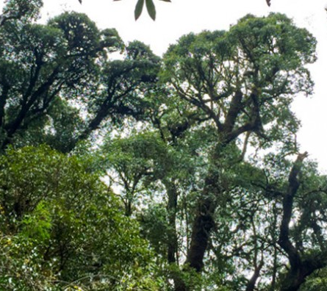
Ancient Tea Trees
Jinxiu Tea Tree (cultivated, 3,200 years) Presumably the oldest tea tree, located in Xiangzhujing, Fenqing county, Lincang. Estimated over 3200 years old. It is the largest ancient cultivated arbor tea tree found in the world. The tea tree is 10.6 meters high, its trunk is 1.84 meters in diameter. Today it is strictly protected as living fossil of ancient tea trees.
Qianjiazhai No.1 Tea Tree (wild, over 2,700 years) Qianjiazhai No.1 Tea Tree is located at Qianjiazhai in Zhenyuan on Ailao Mountain. Found in 1991, The tea tree, has a height of 25.6 meters. It is the largest ancient wild arbor tea tree in the world. It was listed in Guinness World Records in 2001.
Mengku Da Xue Shan No.1 Tea Tree (wild, 2,700 years) Mengku No.1 Tea Tree is located in the Yuku town on the peak of Mengku’s Da Xue Shan (2200-2750 meters above sea level). With a age of 2700 years, Mengku No.1 Tea Tree is 16.8 meters high and its trunk is 3.1 meters in diameter.
Bangwei Tea Tree King (Transitional, 1,700 years) The old tea tree, transitional from the wild to cultivated tree, is located at Bangwei Village, Fudong Town, Lancang County, Yunnan Province. Grown at 1900 meters above sea level, the arbor tea tree king is 11.8 meters high and its trunk is 1.14 meters in diameter. The ancient tea tree of Bangwei is the only ancient transitional tea tree in the world and provides a scientific basis for all kind of tea culture research.
Yuxi Yunanjiang Wild Tea Tree (wild, 1,700 years) Yunanjiang Wild Tea Tree Twins is located in the Nanxi virgin forest near Manlai Town, Yuanjiang County. They are the best-preserved thousand-year-old wild ancient tea trees. The bigger arbor tea tree king is 12.2 meters high and its root trunk is 1.2 meters in diameter.

Slide 11
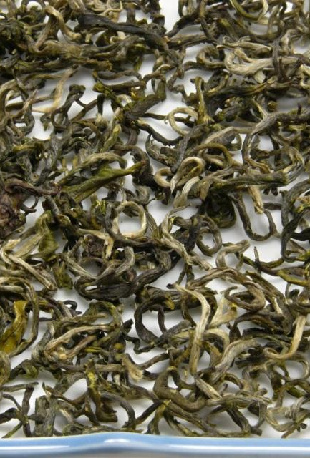
Green Tea
Although it is rare, green tea is produced in Yunnan
The green tea produced in Yunnan is only 1% of the overall green tea production in China.
48% of the tea produced in Yunnan is pu’er.
The raw tea material collected from the mountains of Yunnan, bring in a better price if it is processed into pu’er tea.
Yunnan green tea is rougher and more astringent than green tea from other parts of green tea producing regions, due to the use of the large leaf assamica variety of camelia-sinensis.
Yunnan green tea is usually sold for a less expensive price than other green teas.

Slide 12
Dian Hong
Dian Hong is black tea from the province of Yunnan. Dian, is both an older name for Yunnan and still used as a short version, and Hong, is simply “red”. Therefore, Dian Hong appropriately translates to “Yunnan Red”.
Dian Hong was “discovered” in 1938 during the Sino-Japanese war. Because black tea production close to the East coast of China was hindered by the Japanese invasion, China had to look elsewhere for production. Tea was a crucial export to help China obtain foreign support against the Japanese. At this point Feng Shaoqiu, a tea expert from the China Tea Trade Company and responsible for the popularity of Keemun black tea, was tasked with the mission of finding a new region for producing black tea. Sheltered in the Southwest of China, he discovered that the tea from Fengqing, Yunnan was an ideal area to start producing black tea for export. China wasted no time and began exporting Dian Hong in 1939.
What makes Dian Hong special is that it is produced from the large leaf variety tea tree indigenous to Yunnan. Dian Hong has a unique appearance thanks to the presence golden, strand-like tips in the tea.

Slide 13
Yue GuanG Bai
Yue Guang Bai is an unusual white tea from the Jinggu area of Yunnan Province.
The appearance is the first thing one must notice – each leaf has a fascinating ‘white’ side but the other side is a deep, rich ‘purple/red’. This is because of character traits of the tea bush varietal that is used to make this tea – Camellia taliensis.
Camellia taliensis is a relative of Camellia sinensis, the cultivated tea bush. Both thrive in the mountainous broad-leaf evergreen forests of Yunnan Province, northern Burma and parts of Thailand, where Camellia taliensis has been consumed for centuries by local people.
Yue Guang Bai is a true regional Yunnan specialty. It does not quite fit the exact characteristics of traditional white tea manufacture.
This tea is processed very simply with a short light withering that promotes slight oxidation followed by air drying to keep the leaf as open and flat as possible. This slight natural oxidation imparts a flavor to this leaf that is reminiscent of a very mild black tea.

Slide 14
Maocha
In the broad context of processing teas, the term maocha refers to an unfinished stage: wilted, partially roasted, or otherwise not fully dried and finished. While this unfinished tea might be tasted to gauge the development of flavor or sold to third party roasters, it is almost never offered for sale to consumers, since it is not preserved for storage.
In recent years, pu’er producers have found a market for sheng teas that are not yet aged. With leaves that are still green in color, these teas are referred to as maocha, or unfinished tea, despite the fact that they are fully dried.
Rather than putting them into storage for ten years before finding a buyer, these teas are now sold as-is to the consumer market. While some pu-erh drinkers value these green versions for their existing flavor, others may buy them as an investment, with the intention to age them independently.

Slide 15
Pu’er (sheng)
Sheng, or “raw” pu’er are so named because they are fermented naturally over a long aging period.
This naturally fermented style is rumored to have roots in the Tibetan tea trade, dating back to the Tang Dynasty. For portability, teas from Yunnan and neighboring tea regions were pressed into bricks or cakes, and fermented naturally during the months-long journey to Tibet. On the steppe, the fermented teas were stewed and combined with yak butter to create a nutritionally valuable beverage.
In Yunnan, however, where the teas were harvested and crafted, the indigenous people stewed freshly wilted tea leaves, known as maocha.
Ripened sheng puer, as we know them today, aged and brewed without additives, were popularized in Hong Kong by immigrant populations after the Chinese civil war. Teas imported from Yunnan began their fermentation process during travel and storage, and as the economy grew in the 1960s and 70s, aging became an integral part of the pu’er crafting process. The humid aging environment in Hong Kong facilitated the fermentation process, creating rich, dark teas, with earthy flavor notes like peat and camphor.

Slide 16
Pu’er (Shou)
In the late 1970s, demand for pu’er teas began to outpace the supply from traditional aging processes. To keep up, tea makers developed a technique to accelerate fermentation and imitate well-aged sheng teas. This new style was called shou, or “cooked” pu’er.
To make shou pu’er, the green maocha is heaped into a large pile. Tea makers often mix in a small amount of a previous batch of tea to introduce desirable microbes, and then the leaves are left to ferment. This process works a lot like composting, with the dense pile producing heat that encourages fermentation. The leaves are then turned regularly until they are fully fermented, at which point they may be pressed into cakes, already ready to drink.

Slide 17
WHERE’S THE TEA?
Xishuangbanna (West)
Bulang
Lao Banzhang
Xin Ban Zhang
Banpen
Lao Man’e
Jie Liang
Nannuo
GaoshanBanpo Lao Zhai
Duo Yi Zhai
Ya Kou
Ba Ma
Mensong
Naka
Man Lu
Hekai
Pasha
Bada
Zhang Lang
Xishuangbanna (East)
Mangzhi
Gedeng
Manzhuan
Gaoshan Zhai
Xiangming
Yiwu
Luoshuidong
Yibi
Mahei
Yibang
Mansong
Xi Kong
Mansa
Wan gong Zhai
Yi Shan Mo
Ding jia Zhai
Zhangjia Wan
Gua Feng Zhai
Youle
Longpa
Jinghong
Lincang
Mengku
Bingdao
Da Xue Shan
Shuangjiang Mengku
Mengku Rongshi
Dahusai
Xiaohusai
Nanmei
Bangma
Yongde
Mangfei
Wujia Zha
Yongde Ziyu
Muyechun
Bangdong
Xigui
Nahan
Fengqing
Dasi
Pu’er
Jingmai
Bangwei
Jiangcheng
Jinggu
Xiao Jinggu
Yangta
Kuzhu
Wenshan
Lao Wushan
Fengshan
Malongshan
Wuliang
Alio
Qianjiazhai
Kuzhu
Lao wushan
Kunlu

Slide 18
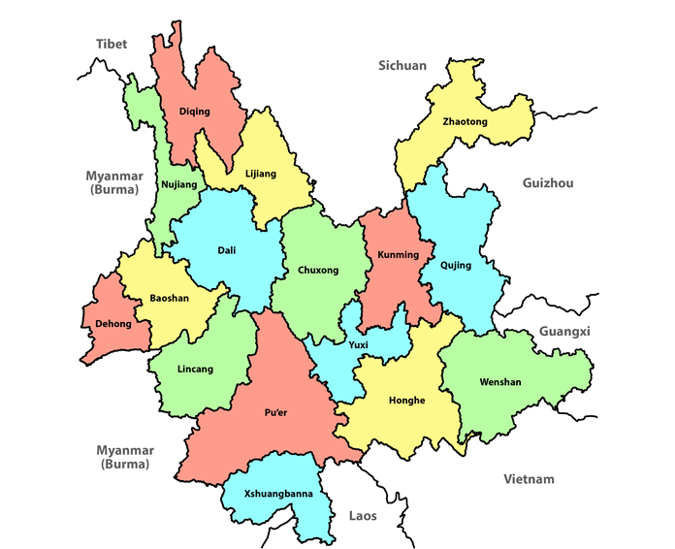
YUNNAN PREFECTURES

Slide 19
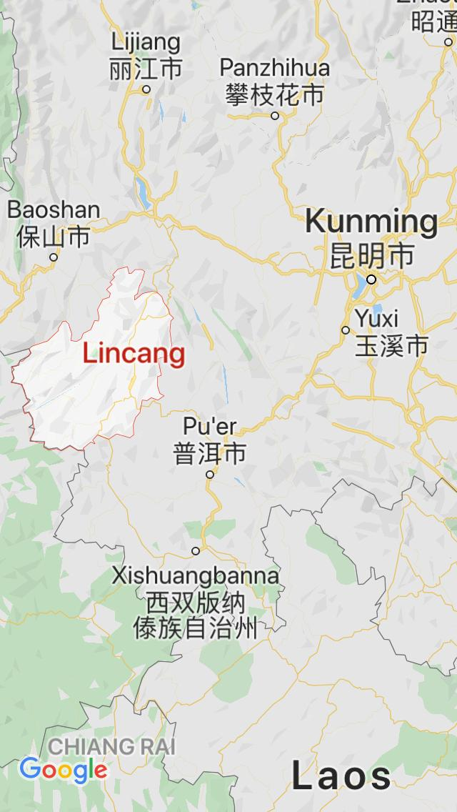
Lincang

Slide 20
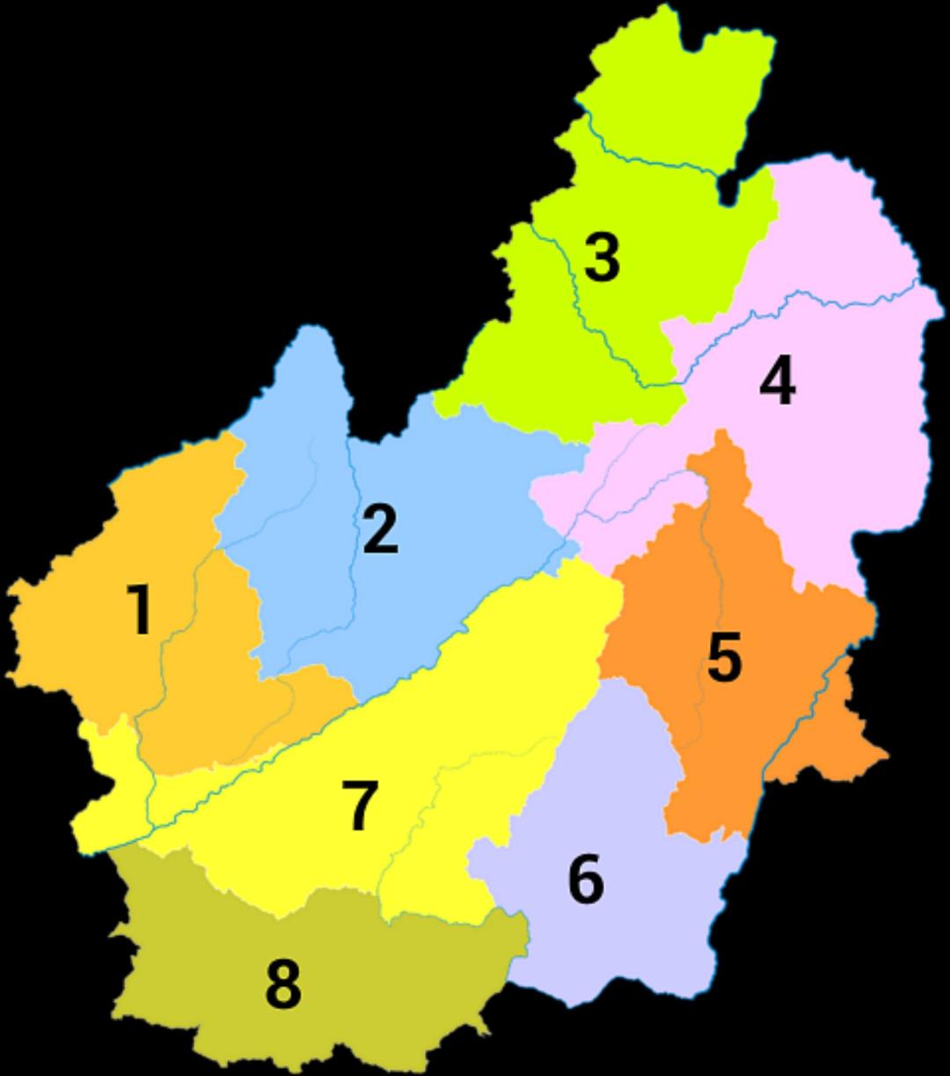
Lincang
Zhenkang County
Ma’an Shan
Yongde County
Mangfei
Fengqing County
Yun County
Baiying Shan
Dachao Shan
Linxiang
Manglu Xigui
Nanmeichu
Fengqing
Shuangjiang County
Bannuo
Bingdao
Donguo
Daxue Shan
Gengma County
Cangyuan County

Slide 21
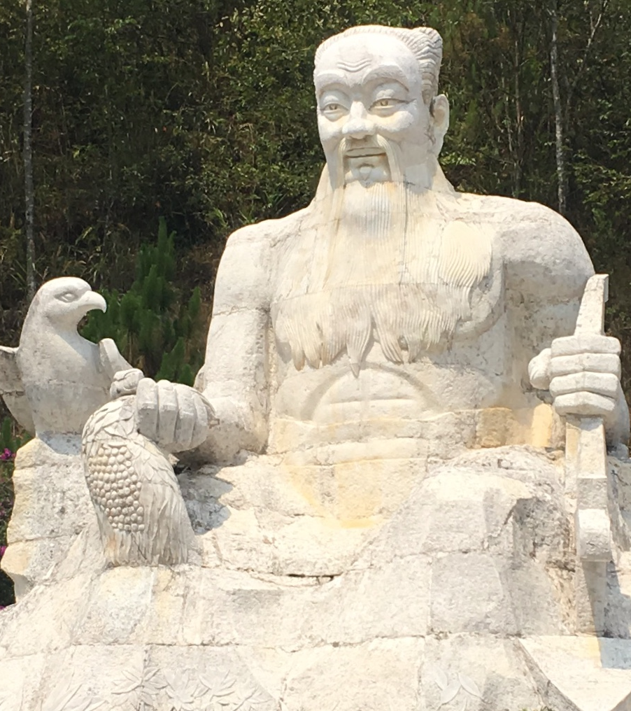
LINCANG
Lincang borders Burma on the west and to the south is Pu’er.
The name of Lincang is due to its proximity to the Lancang River aka Mekong River.
Lincang is the mountainous home of the Wa ethnic minority and was historically seen as too "wild" to be worth settling by neighboring powers, notably British Burma and ancient China. This may have had some connection to the Wa's image as head-hunters.
When Pu’er tea increased in popularity and consumption in 2003, Lincang became a focal area for the production of Pu’er.
Fengqing, is a notable tea region which produces Dian Hong tea.
Despite lagging behind Xishuangbanna in fame and hype, Lincang is home to a few of the most famed and expensive areas in all of pu’er.
The most notable of these is Bingdao.
There are also several Lincang-based factories, including
Shuangjiang Mengku,
Fengqing
Xiaguan
Lincang is home to the world's oldest cultivated tea trees, some 3,200 years old, in the village of Jinxiu of Fengqing County.

Slide 22
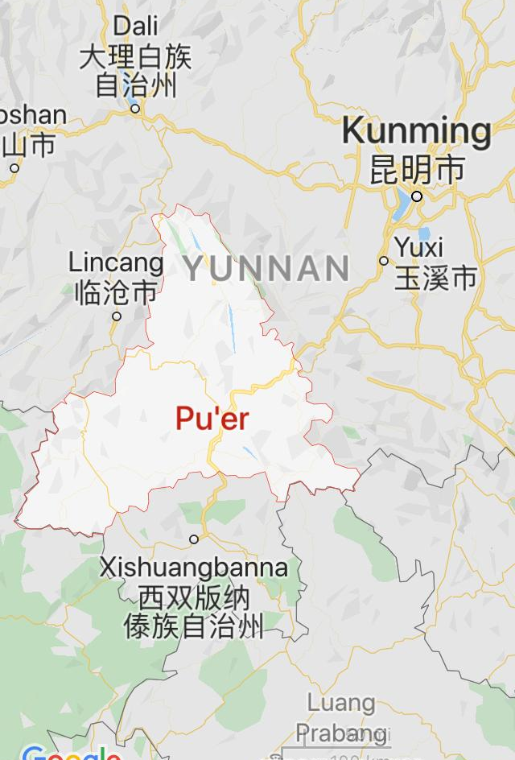
PU’ER (SIMAO)

Slide 23
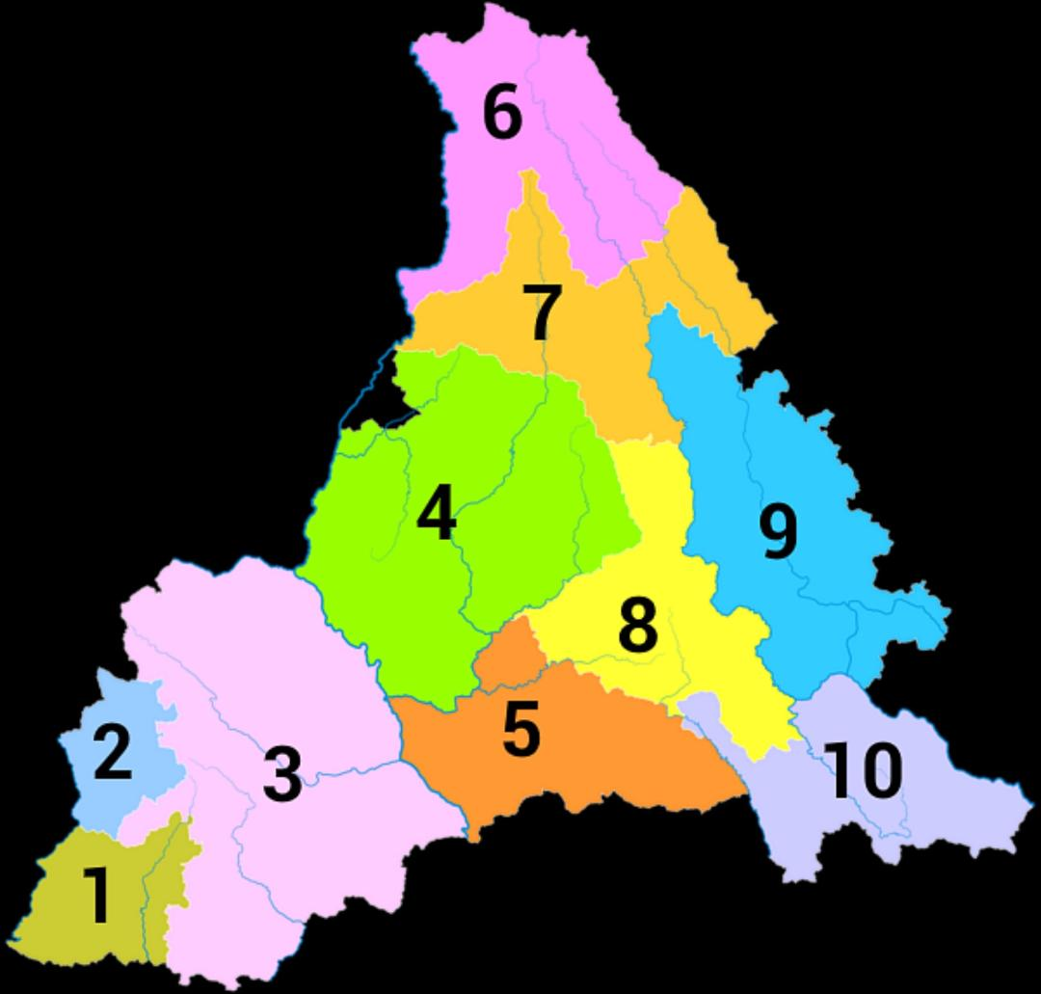
PU’ER (SIMAO)
Pu’er (SIMAO)
Menglian County
Ximeng County
Lancang County
Bangwei
Jingmai
Jinggu County
Qianjiazhai
Jinggu
Simao County
Zhenyuan County
Jingdong County
Wuliang
Ning’er County
Mojiang County
Jiancheng County

Slide 24
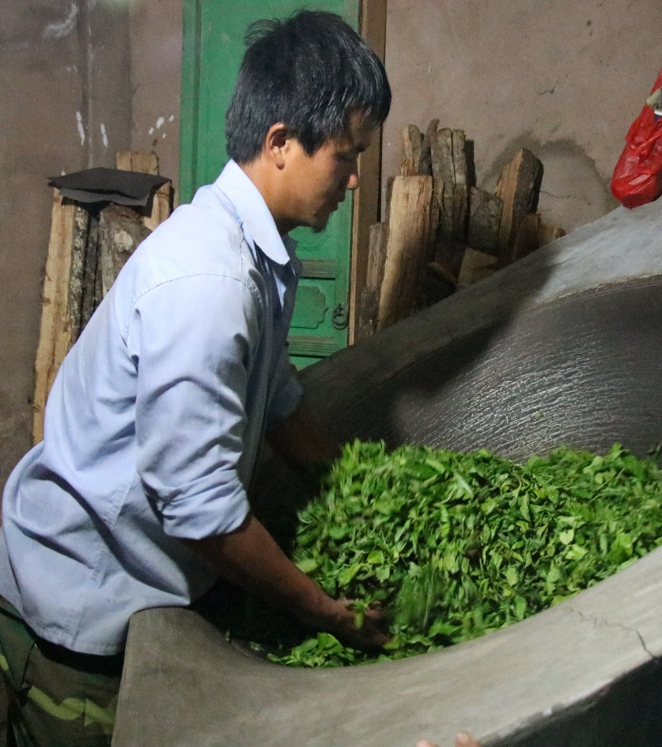
Pu’ER (SIMAO)
Pu’er City is named after pu'er tea, whose name it first took in 1729.
Its name was changed to Simao in 1950 following the Communist victory in the Chinese Civil War, while its surrounding county was known as Pu'er.
In 2007, the town's name was changed back to Pu'er;
the surrounding area became known as Ning'er County;
the name Simao was taken by a town and district within the city.
The Pu-erh region has an extremely large population of ancient wild tea trees.
Not only is Pu’er an important place for the actual growing and production of Pu’er tea, but it is also a major distribution center of Pu’er teas.
A major downturn in the price of tea in 2007 caused severe economic distress
The price of Pu'er has since recovered and Pu'er tea still contributes much to the income of the area.
In ancient times, tea would be sent to the city of Pu’er to be processed before being sold, which is what eventually came to be known as Pu’er tea.
There is also an ancient tea tree in Pu’er which is thousands of years old, called Zhen Yuan, as well as many other old and beautiful tea trees.

Slide 25
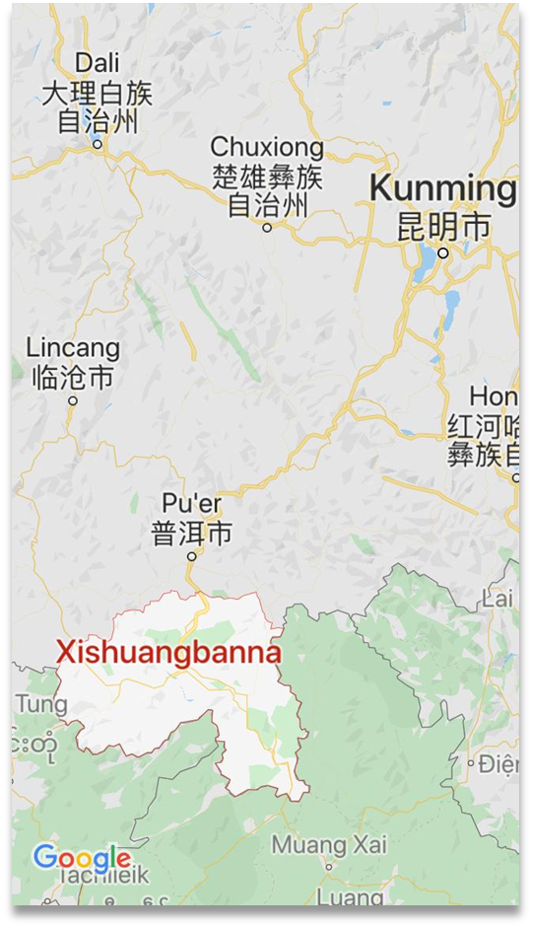
XISHUANGBANNA

Slide 26
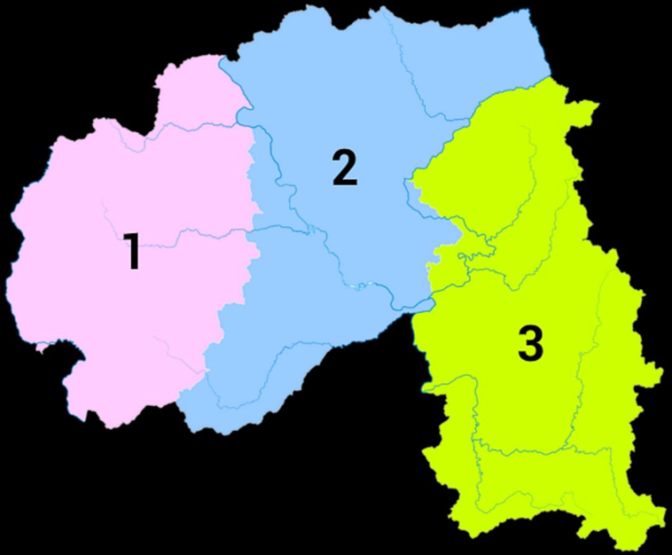
XISHUANGBANNA
1-Menghai County
Nannuo
Banpozhai
Pasha
Bama
Mengsong
Naka
Damalu
Bulang
Lao Banzhang
Xin Banzhang
Lao Mane
Mannuo
Zhangjiazhai
Bada
Zhanglangzhai
Manpalezhai
Hekai
Mannong
Nanqiao
2. Jinghong City
Jinuo Shan (Old Youle)
Menglong
3. Mengla County
Yiwu
Mahei
Gaoshan
Luoshuidong
Manxiu
Sanheshe
Yibi
Zhangjiawan
Yibang
Xikong Sahn
Jiabu Shan
Mangong Shan
Manzhuan
Mangzhi
Gedeng

Slide 27
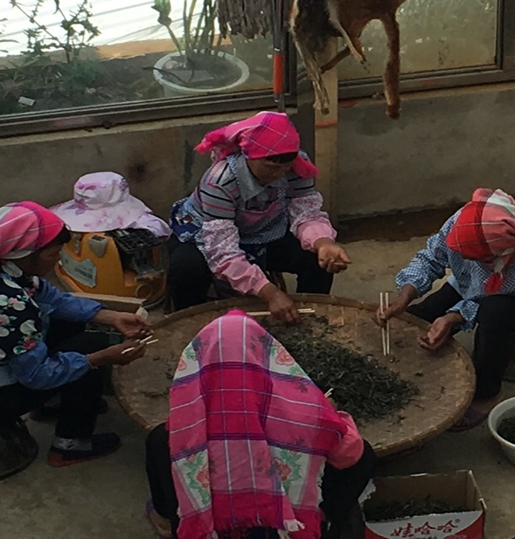
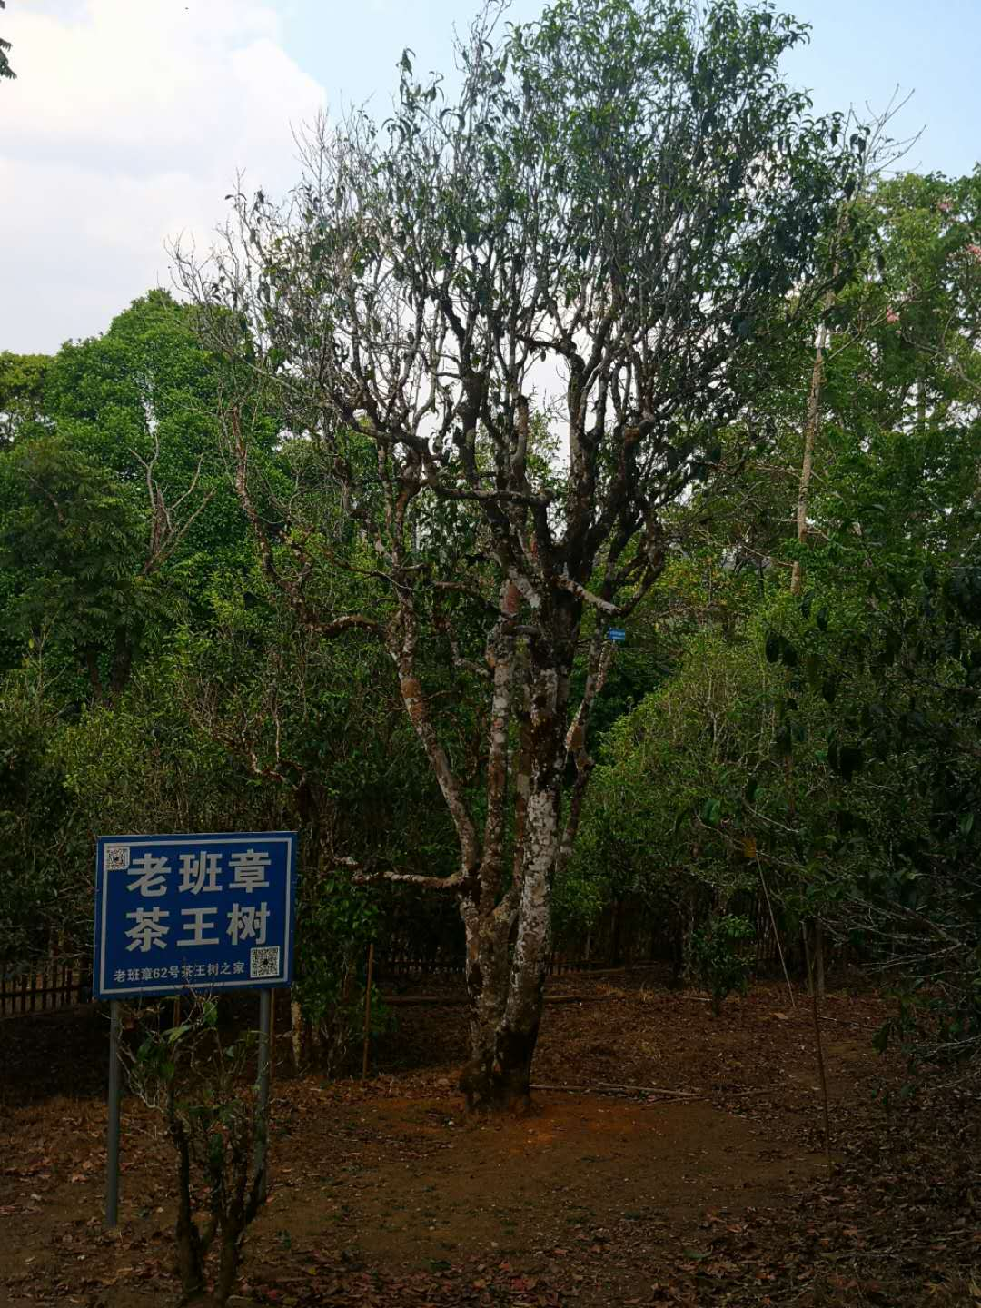
XISHUANGBANNA
According to the recorded history, farmers started to plant tea trees in Xishuangbanna since the Eastern Han Dynasty (25-220).
Tea as an agricultural industry began to rise up from Tang (618-907) and Song Dynasty (960-1279) and reached its peak during Ming (1368-1644) and Qing Dynasty (1644-1912).
Cha Ma Gu Dao which means ‘tea and horse-trading road’ starts from this region and crosses many mountains to outside China territory and worldwide, especially from the middle of 19th century.
It used to be GongCha's chosen area in Qing Dynasty.
GongCha means the tea just for royal family.
Xishuangbanna has 333 km² of tea plantations.
Among that, 86km² are well preserved old tree tea plantation.
Xishuangbanna is home to the "Old Six Famous Tea Mountains"

Slide 28
End of lesson 1

Slide 29
The ‘Old’ Six Famous Tea Mountains
Lesson 2
Gedeng
Yiwu
Mangzhi
Manzhuan
Yibang
Yōulè

Slide 30
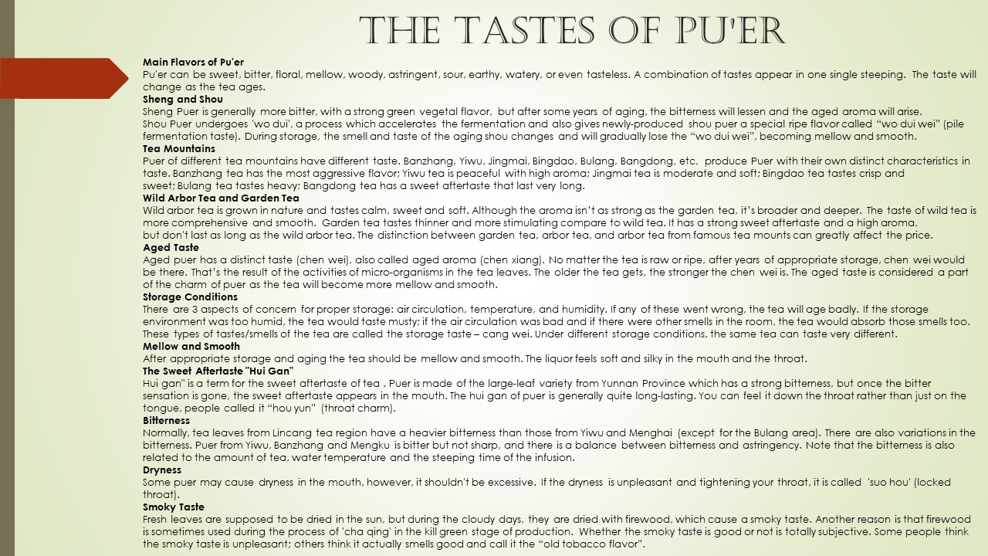

Slide 31
Old Six Famous Tea Mountains
Although tea and particularly pu’er tea is grown and produced throughout the whole of Yunnan, it's primarily the tea mountains that made the province famous.
Well known are the old Six Famous Tea Mountains which are in Xishuangbanna.
In the Qing Dynasty government records for Pu'er, the oldest historically designated mountains were said to be named after six commemorative items left in the mountains by Zhuge Liang.
These mountains are all located northeast of the Lancang River (Mekong) in relatively close proximity to one another.
These are the Old Six Famous Mountains:
Gedeng (革登山): "leather stirrup"
Yiwu (易武山):
Mangzhi (莽枝山): "copper cauldron”
Manzhuan (蠻磚山): "iron brick"
Yibang (倚邦山): "wooden clapper"
Yōulè (攸樂山): "copper gong"

Slide 32
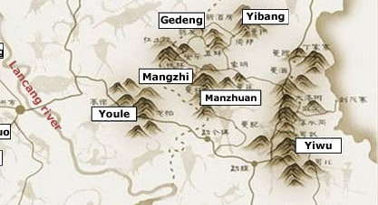
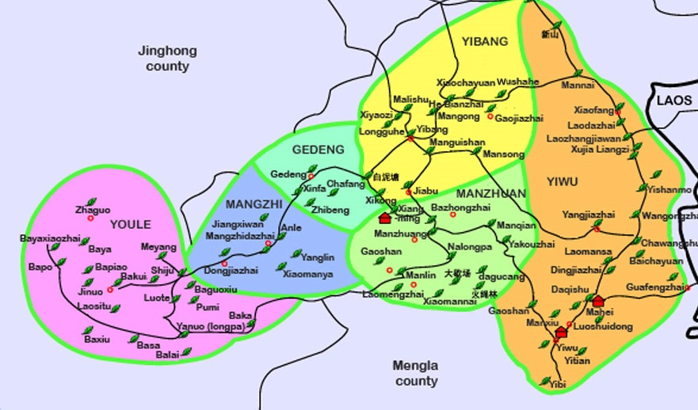
Yunnan’s
Old Six Famous
Tea Mountains

Slide 33
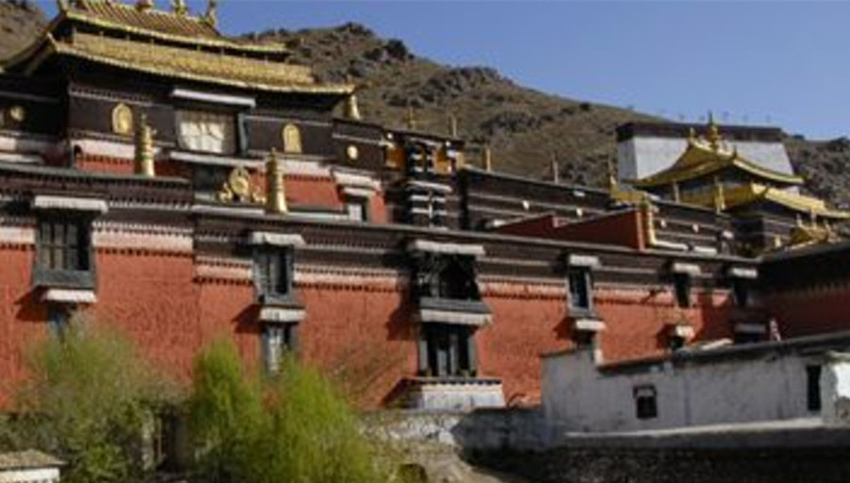
Gedeng
Gedeng Tea Mountain lies in the Xiangming Township of Mengla County, north of Yiwu and to east of the Mangzhi mountains.
The tea district is located at the bottom of Kongming Mountain.
It is linked with Jinuo Mountain and Youle Mountain to form a continuous stretch of tea mountains.
The old tea growing areas are not large, occupying just over 800mu.
The elevation of this area is between 850 and 1900 meters, and it contains extremely visible vertical changes.
Yearly rainfall is between 1,000 and 1,800mm.
There are between 1,600 and 2,000 hours of sunshine per year and a relative humidity of 75%.
The weather is warm and humid all year around with no frost.
Ge Deng teas are special in that they are not large leaf varietal but rather an original small leaf varietal that has grown in this area for thousands of years.
Like other small leaf varietal wild arbor tea trees in Yunnan (Jing Mai), the flavor is lighter and more smooth, but the aroma is pungent and fruity.

Slide 34
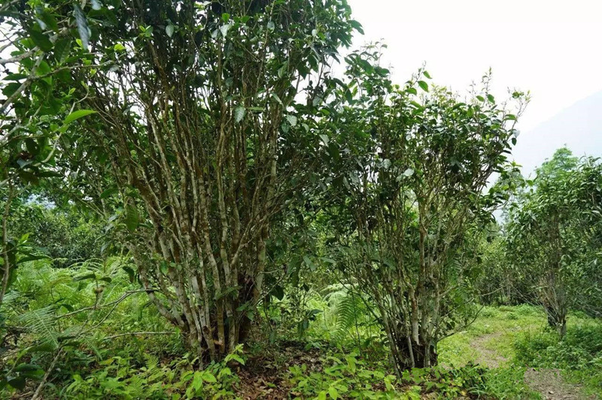
Yiwu
The Yiwu tea growing area is located in the Yiwu Township of Mengla County.
The greater Yiwu region encompasses the four townships of Mansa, Mahei, Yitian and Manluo.
In ancient times, local ethnic Bulang people were the primary growers of tea. By the end of the Qing dynasty, large numbers of Han merchants arrived in Yiwu and began growing tea. They founded businesses to engage in the tea trade, establishing a collection point among the six famous tea mountains. In practice the Yiwu tea district also includes Mansa Tea Mountain.
Today the Yiwu tea growing areas are approximately 15,000mu (1mu = 1/6acre) in size and produce approximately 600 tons of tea per year.
They lie between 820 and 2000 meters in elevation and have a very marked topography.
Yearly rainfall is between 1,000 and 1,800mm.
There are between 1,600 and 2,000 hours of sunshine per year and a relative humidity of 80%.
The weather is warm and humid all year around with no frost.
Because Yiwu is a township and a county, it is ambiguous as to what exactly constitutes “Yiwu”. This has not stopped tea producers from constantly marketing and using the Yiwu name to sell tea.
Tea from Yiwu has little bitterness and a high orchid like fragrance.

Slide 35
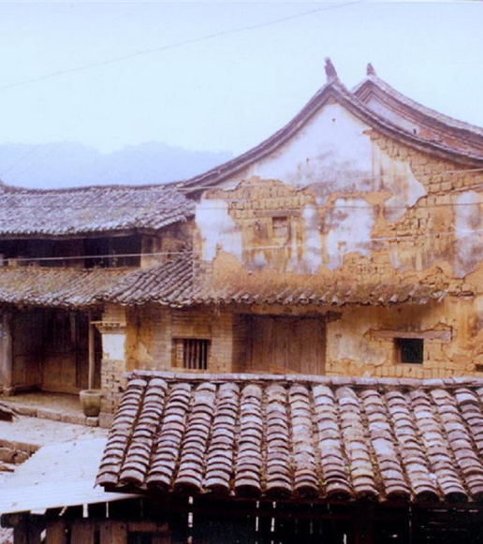
History of Yiwu Mountain
Historically, Yiwu is famous for being the center of distribution for tribute tea to be sent to the emperor. The six famous tea mountains produced mao cha where it would be collected and sent out to Beijing from Yiwu. This trade brought a large number of Han merchants to the area to trade tea. Some of the more famous examples of aged pu’erh (from the 1930s) also originated here. i.e. Fuyuanchang, Tongqin Hao and Songpin Hao.
From the 1940s until the 1990s, tea production shifted away from these regions to Menghai County where Menghai Tea Factory planted ground. During this period, tea that was produced was usually unceremoniously sold as raw mao cha to the larger factories.
When China began to open up to the west, many Taiwanese traders visited Yiwu hoping to find both tea production and more aged tea. They found neither, but ended up helping the locals to restart tea production. As a result, the greater Yiwu area has strong ties with the Taiwanese market. Many of the Taiwanese pu’er brands have strong ties to this region. This is covered far more thoroughly in Zhang Jinghong’s Ancient Caravans and Urban Chic.
In Zhang’s book she characterizes the Taiwanese and Yiwu style as emphasizing the hand-made and traditional aspects of tea-making, a supposed contrast from the more production oriented Menghai County tea.
Yiwu tea operations tend to be smaller, often family-oriented, whereas Menghai County is more densely populated with major operations, i.e. Menghai Tea Factory .

Slide 36
Mangzhi
Mangzhi Tea Mountain lies in the Xiangming Township of Mengla County.
Mangzhi is a small village of Yi and Yao people, just north of Yiwu town in the vicinity of Yibang and Xikong villages.
It is located in the area between Yibang, Manzhuang, and Gedeng mountains.
The area of tea under cultivation is not large.
In the past, it fell out of cultivation and became a dense old growth forest.
Beginning in the 1980’s, Mangzhi was once again developed for cultivation.
The elevation of this area is between 850 and 1950 meters, and it contains extremely visible topography.
Yearly rainfall is between 1,000 and 1,800mm.
There are between 1,600 and 2,000 hours of sunshine per year and a relative humidity of 80%.
The weather is warm and humid all year around with no frost.
The brewed tea is aromatic, thick and sweet with a high level of aroma and cha qi. It is not entirely lacking in bitterness and astringency.
Mang Zhi village tea leaves are dark olive-green color when brewed.

Slide 37
Mangzhuan
Manzhuan Tea Mountain lies in the Xiangming Township of Mengla County.
It is located beside Yexiang Mountain, with Mozhe River running between the two mountains. It sits between Yibang, Gedeng, Mansa and Yiwu
The elevation of this area is between 850 and 1900 meters, and it contains extremely visible topography.
Yearly rainfall is between 1,000 and 1,800mm.
There are between 1,600 and 2,000 hours of sunshine per year and a relative humidity of 75%.
The weather is warm and humid all year around with no frost.

Slide 38
Yibang
Yibang Tea Mountain lies in Xiangming Township of Mengla County.
In the Dai language, Yibang is known as “Mola.” It
Yibang encompasses six villages, and the terrain is dominated by mountains.
This area is home to numerous ethnic minority people.
Yibang’s Mansong village tea was once offered as imperial tribute tea, since Mansong village tea was considered the best in Yibang.
Yibang tea trees are mostly old trees.
The mountain contains a relatively large number of tea varieties.
Large leaf, medium leaf and small leaf varieties are all distributed throughout the area.
Among them, small leaf varieties are of higher quality than the area’s big leaf varieties.
The elevation of the Yibang area is between 850 and 1900 meters, and it contains extremely visible topography.
Yearly rainfall is between 1,000 and 1,800mm.
There are between 1,600 and 2,000 hours of sunshine per year and a relative humidity of 75%.
The weather is warm and humid all year around with no frost.

Slide 39
Youlè
Youle Tea Mountain, also known as Jinuo Mountain, derives its name from being the primary residence of the Jinuo people.
Today it is classified as a township of Jinghong city and includes the three towns of Manci, Shizui, and Sitong.
To the northeast, it borders the tea mountain of Gedeng, while to its southwest is Xiaomengyang.
It is the head of the ancient six famous tea mountains and has a long tea growing history as the center of this large mountain tea growing area.
Today the Youle tea growing area is around 4,500mu and produces around 200 tons of tea yearly.
The tea growing areas are between 570 and 1,650 meters in elevation.
It is part of the northern tropics, with a yearly rainfall of 1,000 to 1,800mm.
There are between 1,600 and 2,000 hours of sunshine per year and a relative humidity of 85%.
The weather is warm and humid all year around with no frost.

Slide 40
End of lesson 2

Slide 41
The ‘NEW’ Six Famous tea Mountains
Lesson 3
Bulang
Jingmai
Menghai
Nannuo
Yiwu
Youle

Slide 42
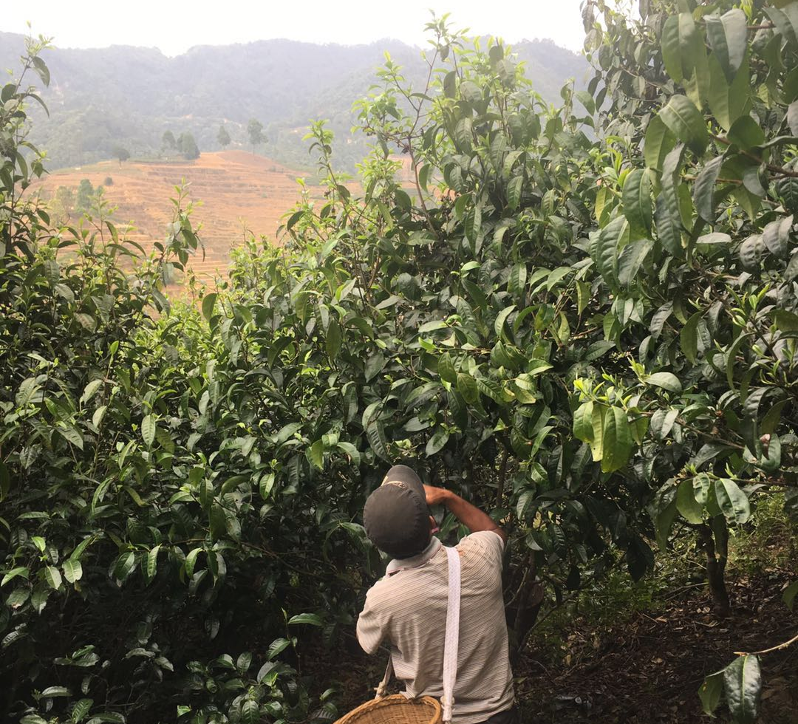
New Six Famous Tea Mountains
Around the end of the Qing dynasty, tea production in the old famous tea mountains dropped dramatically, either due to large forest fires, overharvesting, prohibitive imperial taxes, or general neglect.
To revitalize tea production in the area, the Chinese government in 1962 selected a new group of six great tea mountains that were named based on the more important tea producing mountains at the time, including Youle mountain from the original six.
Currently, the following areas are considered as the New Six Famous Tea Mountains:
Bulang
Jingmai
Menghai
Nannuo
Yiwu(Mansa)
Youle(Jinuo)

Slide 43
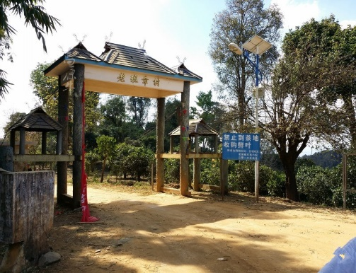
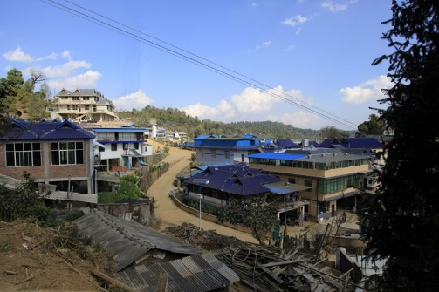
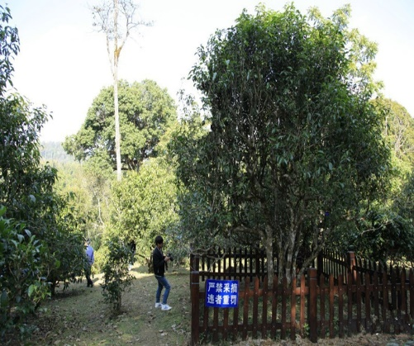
Bulang
Lao Ban Zhang
Lao Mane
Banzhang Tea Mountain is located in Banzhang Village of Bulangzu Township, Bulang Mountain, Menghai County.
It is located 63km from the Menghai county seat.
Bulang Mountain’s Bulangzu Township covers an area of 1,016 square kilometers with a population of only 18,000 people.
Mountains cover 93% of its land area.
The elevation of this area is between 600 and 2100 meters.
Two thousand years ago, Pu people were already living here (the Pu were earliest indigenous people in Yunnan).
The ancient Pu people were the earliest ancestors of Yunnan tea and the first to cultivate, produce, and drink tea.
Banzhang is just a simple village, but the tea it produces possesses overpowering chaqi and intense huigan. As a result, it has become famous throughout the world.
To tea lovers, Banzhang village has become one of the holy places of Puerh tea.
Lao Mane Tea Mountain is located in Old Mane Village of Bulangzu Township, Bulang Mountain, Menghai County.
It is located 70 km from the Menghai county seat.
It has a tea growing history of over 900 years.
Today Lao Mane village has 128 households and a total of 614 residents.
There are 3,205mu of preserved ancient tea gardens and 852mu of new tea gardens.
Lao Mane lies at an elevation of 1,700meters.
Tea mountains stretch in a continuous chain traversed by ravines. T
he climate is warm and provides ample sunshine.
Rain is plentiful and the soil is rich.
Along with Banzhang, Lao Mane belongs to the Bulang Mountain tea region.

Slide 44
Jingmai
The Jingmai tea growing area is located in the Puerh Prefecture, Lancang County township of Huimin.
It borders Menghai County in Xishuangbanna.
The Jingmai tea growing area covers the Lancang County villages of Jingmai and Mangjing.
This stretch of 10,000mu cultivated ancient tea gardens has upwards of 1000 years of history.
Scholars believe the Jingmai Tea Mountain was first cultivated over 1200 years ago in 696 A.D. by the ancestors of the Bulang people.
The next several dynasties saw a succession of tea planting, leading to the current scale of over 10,000mu under cultivation.
Within the ancient tea forest, tea trees are mixed in with the rest of the forest. This has created a fine natural ecology, which is a good example of an ecological tea garden.

Slide 45
Menghai
Hekai
Bada
Mensong
Hekai Tea Mountain is located in the southeast of Menghai County in Hekai Village of Menghun Town.
The primary ethnic groups are Hani and Lahu.
It is located 50km from the Menghai county seat and belongs to the northern section of the Nannuo mountain chain.
Hekai Tea Mountain is divided into Manmai and Mannong old and new villages.
It contains Xishuangbanna’s best preserved and largest ancient tea gardens.
The tea gardens are primarily distributed along mountains and hills between 1,170 and 1,800 meters.
Mountains cover 93.5% of its land area.
It possesses a southern subtropical, monsoonal climate and receives plentiful rainfall.
The yearly average temperature of 18.1°C and relative humidity is 82%.
The climate is warm and moist, providing superior natural conditions for growing tea trees.
The areas around the tea mountain have luxuriant tree growth. A natural environment with excellent tree cover creates a harmonious tea garden landscape where “the forest contains tea and the tea contains a forest.”
Today there are nearly 8,000mu of ancient tea gardens in the Hekai tea growing area, which produce approximately 250 tons of high-quality tea per year.
The Bada tea growing area is approximately 60km west of Menghai.
Originally this was known as the Bada Bulang and Hani Township, but in 2004 it and the Xiding Hani Township were merged to form the Xiding Hani and Bulang Township.
Bada Mountain is at the border of Xishuangbanna and Myanmar.
Bada Mountain is a mountain area in the truest sense, with 100% of its territory mountainous.
Its highest elevation reaches 2,249 meters, and its lowest is along the banks of the Nanlan River at 668 meters.
The yearly average temperature is 17°C, and relative humidity is 85%.
Beda’s high, empty mountains and deep rivers cover a vast area.
Today it contains the largest old growth forest in Xishuangbanna.
Bada’s Xiaohei Mountain is also one of the primary wild animal habitats in Xishuangbanna.
The Bada wild tea tree in Hesong village has been proclaimed “the king of tea trees.” It is 34 meters tall and its primary trunk spreads out 3.8 meters and is approximately 1 meter in diameter. It is the largest currently known wild tea tree.
The Bada ancient tea gardens are concentrated near Manmai Village and occupy nearly 2000mu.
Every year between April and October, thick fog shrouds all of Bada Mountain.
Tea can be harvested ten months out of the year. During the 1980’s, Menghai Tea Factory built a nearly 10,000mu tea plantation in Bada.
The Mengsong (Menghai) tea growing area is located 25 kilometers from the Menghai county seat.
It is primarily inhabited by people of Dai and Lahu ethnicities.
The elevation of this area is between 870 and 2,219 meters.
It has a southern subtropical, monsoonal climate and a yearly average temperature of 18°C.
It has plentiful rainfall and sunshine and a long frostless season. Combined with the rich fertile soil, this area has excellent conditions for growing tea trees.
Along with the Nannuo tea growing area, Mengsong is one of the tea growing areas of Xishuangbanna with the longest history.
Today its old tea gardens cover nearly 4,000mu.
They are primarily distributed in Da’an village, Nanben old village, Nake village, and Baotang old village.
New tea plantations cover over 40,000mu.
The area has a yearly tea output of nearly 1,000 tons.

Slide 46
Nannuo
Nannuo Tea Mountain is located in Bulanghe Township of Menghai County and is mainly inhabited by ethnic Hani people.
It lies 22km from Jinghong and 20km from Menghai.
During the 1920’s, the Republic of China government established Yunnan’s earliest tea industry testing ground at Nannuo Mountain.
The Nannuo Mountain area contains vast tea growing areas and possesses a long history of growing tea.
Its history of tea cultivation can be traced back to the Tang dynasty (618-920AD).
It is also the oldest test-bed of industrialization in Xishuangbanna.
Today there are still more than 10,000mu of remaining Nannuo Mountain old tea gardens.
Combined with the past several decades of development in tea cultivation, this has made Nannuo an important source of raw tea material for the Menghai area.
Nannuo Mountain has a mild climate with a yearly average temperature of 18.7°C.
Lying at elevations between 800 to 1500m, it serves to divide the climates of Menghai and Jinghong.
Temperatures range from 3°C to 33.5°C.
It is said to possess: “winters without brutal cold, and summers without extreme heat.
There are many foggy days, but ample amounts of warm sun.
Rainfall is plentiful.
Average relative humidity is 78%.T
here are an average 100 to 150 foggy days per year, which makes Nannuo a fine example of the saying “High, foggy mountains produce famous tea.”

Slide 47
Yiwu
The Yiwu tea growing area is located in the Yiwu Township of Mengla County.
The greater Yiwu region encompasses the four townships of Mansa, Mahei, Yitian and Manluo.
In ancient times, local ethnic Bulang people were the primary growers of tea. By the end of the Qing dynasty, large numbers of Han merchants arrived in Yiwu and began growing tea. They founded businesses to engage in the tea trade, establishing a collection point among the six famous tea mountains. In practice the Yiwu tea district also includes Mansa Tea Mountain.
Today the Yiwu tea growing areas are approximately 15,000mu (1mu = 1/6acre) in size and produce approximately 600 tons of tea per year.
They lie between 820 and 2000 meters in elevation and have a very marked topography.
Yearly rainfall is between 1,000 and 1,800mm.
There are between 1,600 and 2,000 hours of sunshine per year and a relative humidity of 80%.
The weather is warm and humid all year around with no frost.
Because Yiwu is a township and a county, it is ambiguous as to what exactly constitutes “Yiwu”. This has not stopped tea producers from constantly marketing and using the Yiwu name to sell tea.
Tea from Yiwu has little bitterness and a high orchid like fragrance.

Slide 48
Youlè
Youle Tea Mountain, also known as Jinuo Mountain, derives its name from being the primary residence of the Jinuo people.
Today it is classified as a township of Jinghong city and includes the three towns of Manci, Shizui, and Sitong.
To the northeast, it borders the tea mountain of Gedeng, while to its southwest is Xiaomengyang.
It is the head of the ancient six famous tea mountains and has a long tea growing history as the center of this large mountain tea growing area.
Today the Youle tea growing area is around 4,500mu and produces around 200 tons of tea yearly.
The tea growing areas are between 570 and 1,650 meters in elevation.
It is part of the northern tropics, with a yearly rainfall of 1,000 to 1,800mm.
There are between 1,600 and 2,000 hours of sunshine per year and a relative humidity of 85%.
The weather is warm and humid all year around with no frost.

Slide 49
End of lesson 3

Slide 50
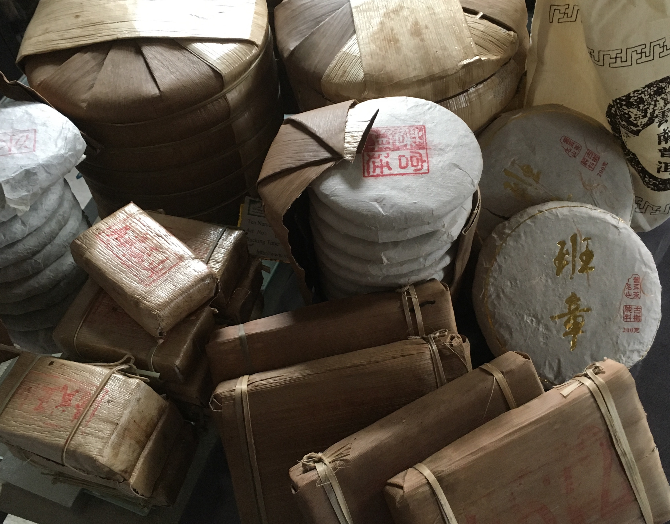
OTHER NOTABLE INFORMATION
Lesson 4
Compressed Pu’er Shapes
Famous Tea Factories
Other Notable Regions

Slide 61
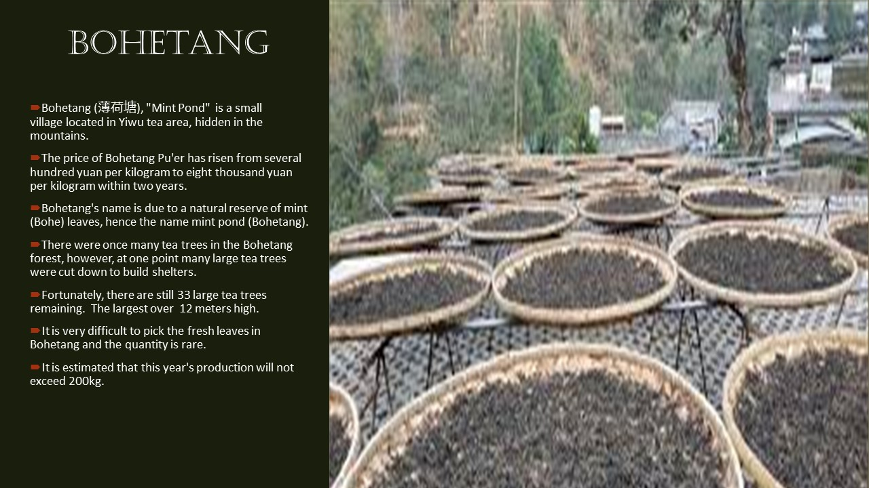

Slide 64
End of lesson 4

