Slide 1
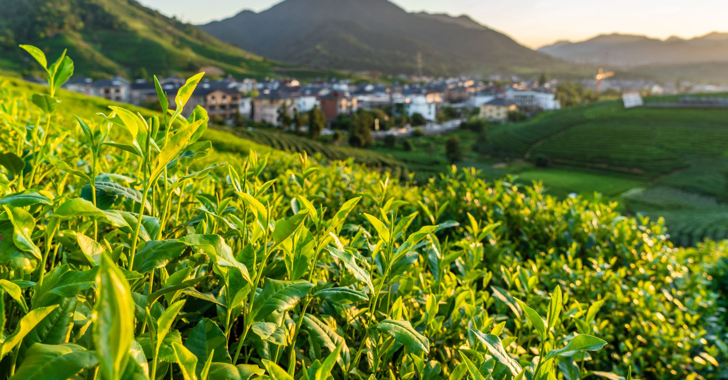
The Fascinating World of Oolong Tea…

Slide 2
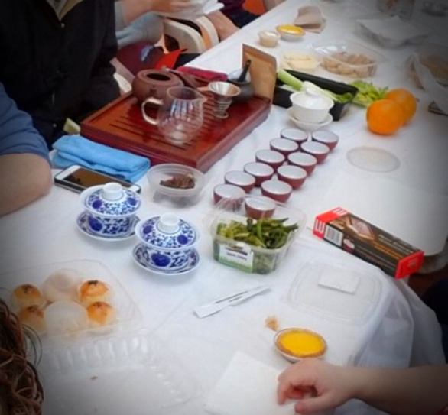
What Will We Discuss?
Tea Vs. Tisane
What is Tea
The Five Categories of Tea
What is Oolong Tea
The 4 Major Categories of Oolong Tea
Tea Brewing Styles

Slide 3
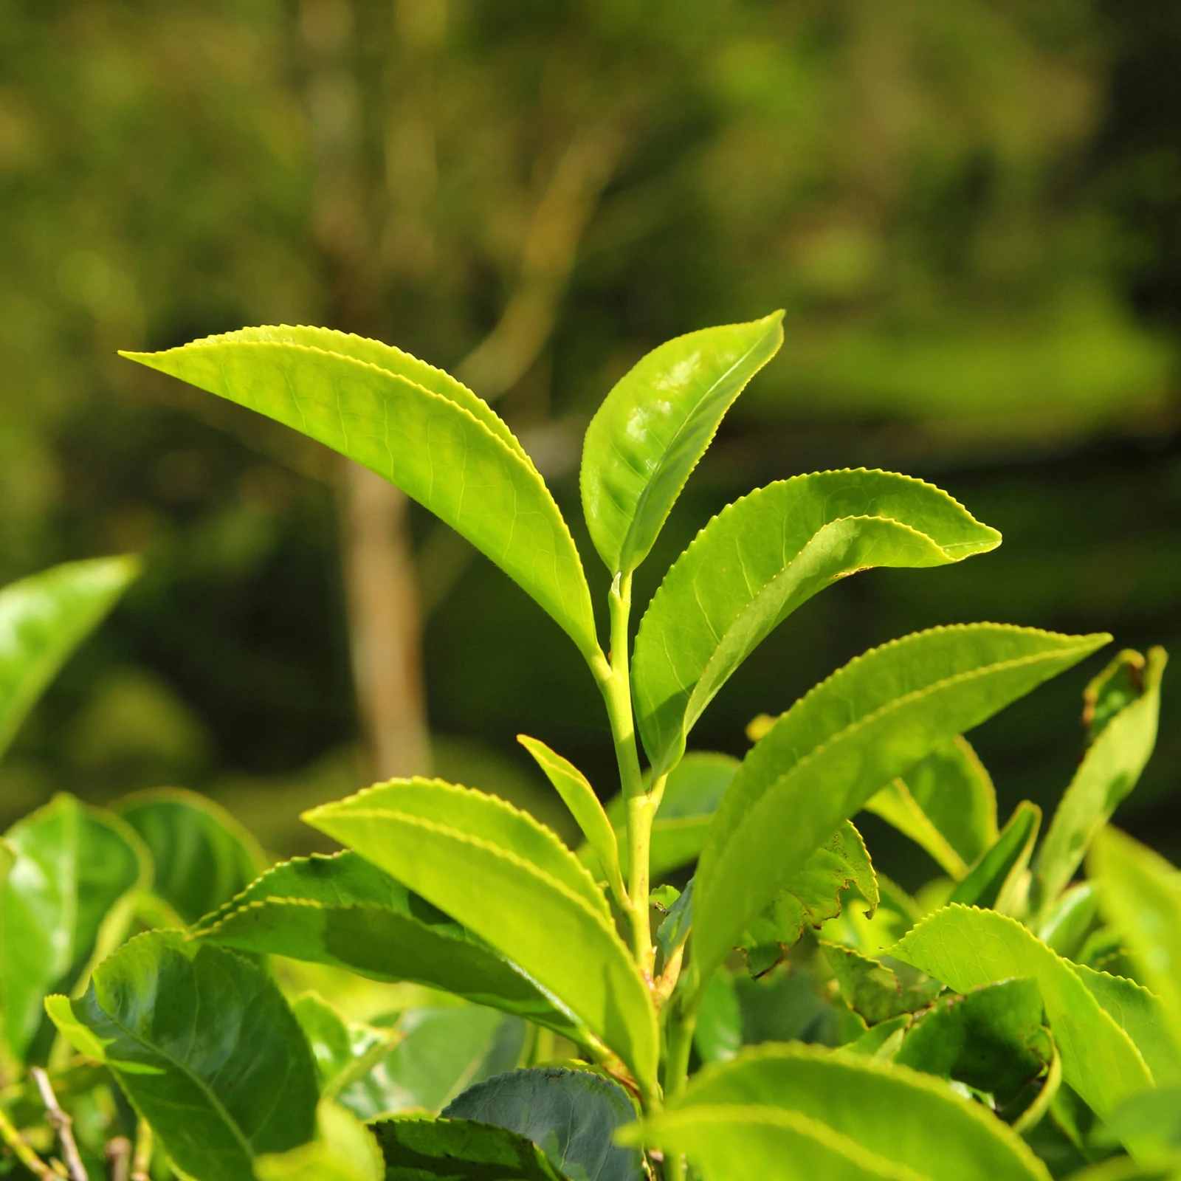
Tea vs Tisane
Although many people do not differentiate tea from tisane and call all hot or cold infused beverages tea, the two are defined differently
The difference between the two depends on what ingredient is being infused.

Slide 4
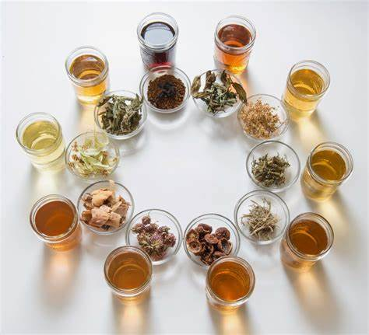
What Is Tisane?
Tisane (pronounced ti-zann) is an infusion made from the leaves, flowers, roots or any part of a plant which does not belong to the Camellia Sinensis family.

Slide 5
What Is Tea?
Tea is an aromatic beverage prepared by pouring hot or boiling water over fresh or fermented leaves of Camellia Sinensis

Slide 6
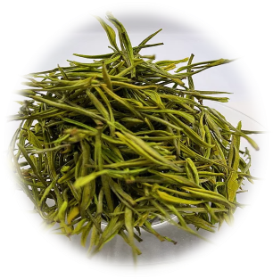
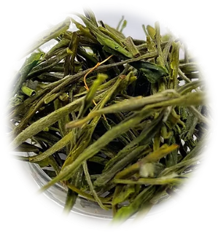
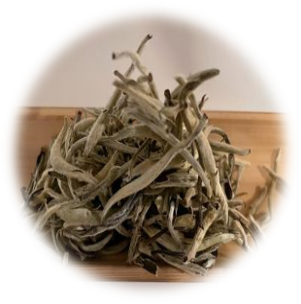
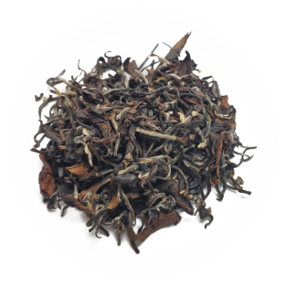
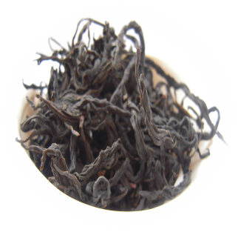
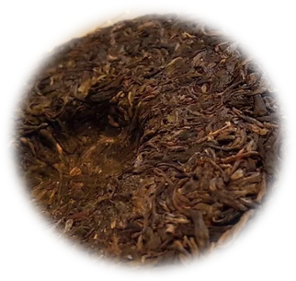
~~~SIX CATEGORIES OF TEA~~~
Green
Yellow
White
Oolong
Black
Fermented

Slide 7
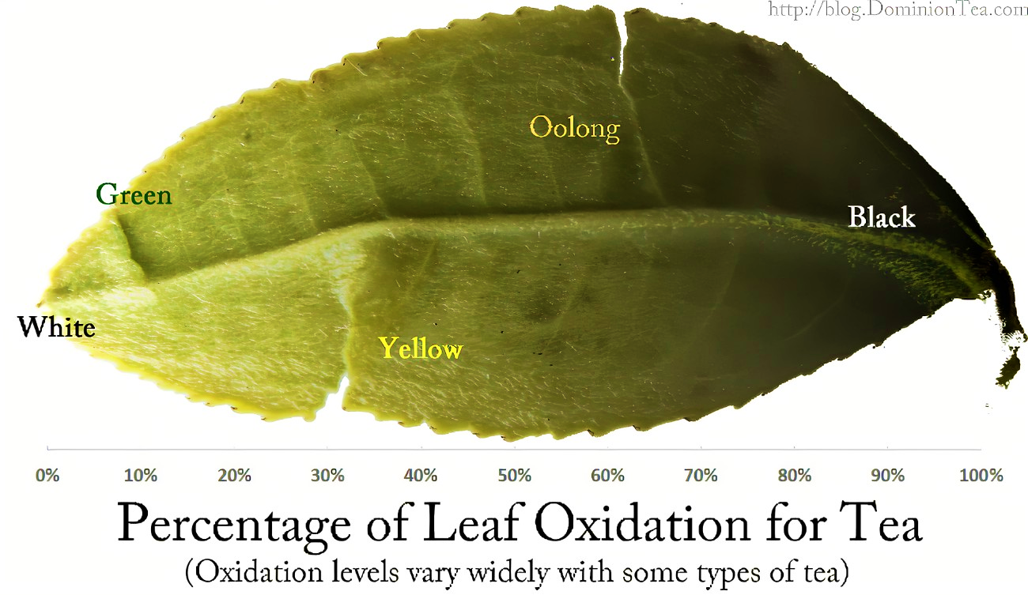
One Plant Origin
All teas originate from the Camellia Sinensis plant.
Teas develop their unique characteristics through the many different choices made by the farmer during harvesting, processing and storing
Hand pick or machine pick
Pick the bud only or 1, 2, 3 or 4 leaves and the bud
Stem or no stem
Steam, pan-fire, or sun-dry
Fully oxidize, partially oxidize or not oxidized
Hand-formed into tightly rolled balls, strips, roughly chopped, or left to air-dry in their natural shape
Early spring harvest, summer harvest or fall harvest
Charcoal roast, electric roast, or no roast
Although these choices will make 1000’s of different kinds of teas, the predominant difference between the six main categories of tea is the level of oxidation
Oxidation Level

Slide 8
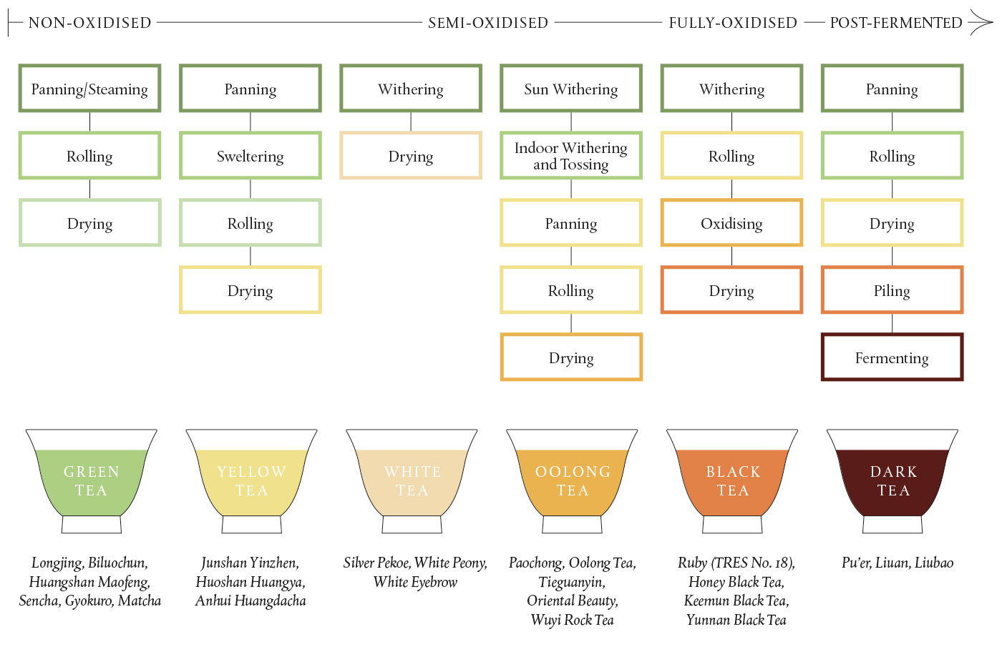

Slide 9
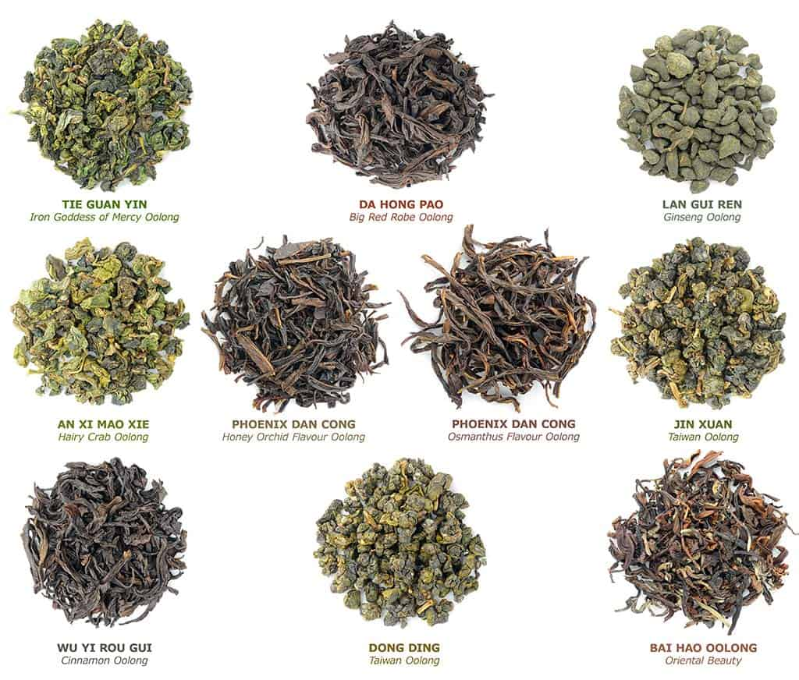
What Is Oolong Tea?
Oolong tea is a semi-oxidized tea
Oolongs can range between 10% and 95% oxidation
The name Oolong derives from ‘Wu Long’
One story claims that the Chinese bestowed the name “wulong” or “dark dragon” because the dark tea leaves, which were heavily oxidized and twisted into shapes that resemble a dragon.
Another story claims that a tea farmer named Wu Liang (later shortened to Wulong) discovered the oolong style of tea by accident.
The farmer was distracted after a long day of tea picking and upon returning to his withering tea leaves, he discovered they had already started to oxidize.
Oolongs are produced in 4 main regions
Fenghuang Shan (Phoenix Mountain)
Dancong
Mi Lan Xiang
Ya Shi Xiang
Song Zhong
Wuyishan, Northern Fujian Province
Yancha
Da Hong Pao
Rou Gui
Qilan
Anxi, Southern Fujian Province
Tieguanyin
Mao Xie
Zhanpin
Taiwan
Gao Shan (High Mountain)
Mi Xiang
Dong Ding

Slide 10
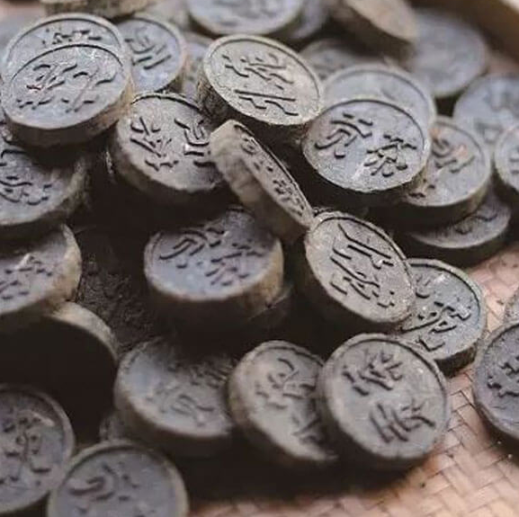
A Brief History of Oolong Tea
Oolong tea dates to the Song dynasty (960 to 1279) when it was known as Beiyun tea, named after the Beiyun region of Fujian Province, where it was produced.
Beiyun tea was one of the first ever Imperial tribute teas.
A Tribute Tea is a tea which was selected by the emperor as worthy enough to be served to the imperial family
During this era, the northern region of Fujian, known as Wuyi Shan, was also well-known for making tea cakes or compressed cakes of tea.
This type of tea was usually whipped, much like matcha is steeped today.
The practice of charcoal roasting and semi-oxidizing tea leaves (distinct to oolong tea) came into full practice during the Ming Dynasty (1368 - 1644), when tea cakes were banned by the emperor, to put a stop to corruption and the monopoly in tea trade.
Rather than dying out, the tea industry thrived in new ways like using charcoal to dry out the tea leaves.
Tieguanyin Oolong became popular during the Qing Dynasty when it caught the attention of the Emperor Qianlong
In the mid-1900s Taiwan began oolong production
Today oolong tea can be found in all tea growing regions around the world, but the most prized oolong teas still comes out of Fujian, Anxi, Guandong and Taiwan.

Slide 11
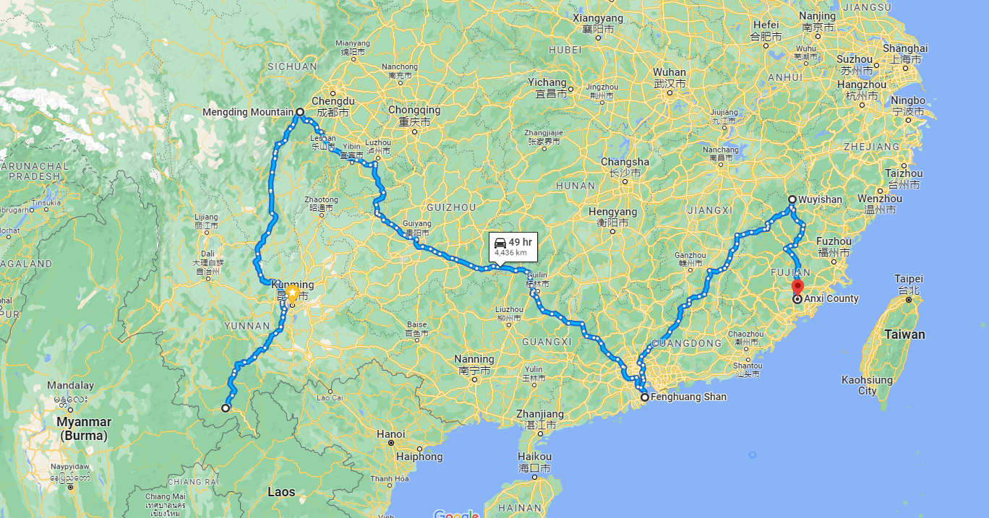
1st Cultivated Tea (53-50 BC)
2 - Yancha
3 – Tieguanyin
4 – Taiwanese
Oolong
The Birthplace of Tea
(6000-3000 BC)
1 - Dancong

Slide 12
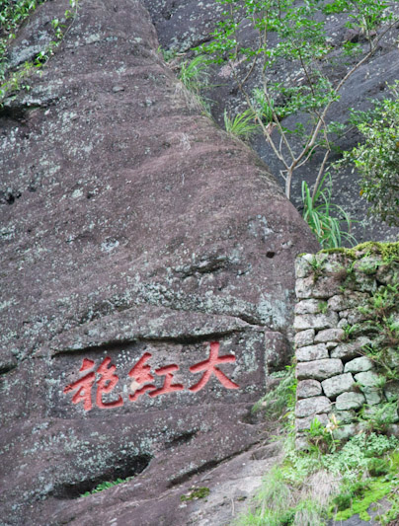
Da Hong Pao​ Oolong​
During the Ming Dynasty, the emperor’s wife had grown gravely ill.
He sought the advice of every doctor in the land to try and save his wife, however, nothing could be done to save the dying empress. ​
He then offered a reward to anybody in the land who could save his wife. ​
A farmer came to him with a tea which he had made from the leaves of a bush that grew on a high and steep cliff near his home. ​
As soon as the tea touched the lips of the empress, she began to regain her health. ​
The emperor was so pleased that he honored the farmer with a gift of his imperial red robes. ​
In response, the farmer named the tea Da Hong Pao (Red Robe Tea).​

Slide 13
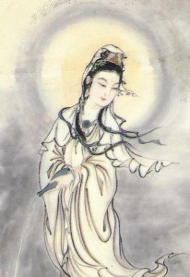
Tieguanyin Oolong​
In the center of Anxi Town, there was a neglected temple that had an Iron Statue of Guan Yin, the Bodhisattva of Compassion.
Every day, on the way to his tea fields, an old tea farmer named Wei passed by the statue and reflected how beautiful the temple was and how poorly it was kept.
Something had to be done, he thought, however, being poor, he lacked the means to restore the temple.
He brought a broom and some incense, cleaned the temple and lit the incense as an offer for Guan Yin. "It's the least I can do".
He repeated the task at least twice a month for many months after.
One Night, Guan Yin appeared in his dream and told him about a cave behind the temple where a treasure was waiting for him, which he had to take and share with others.
At the cave, the farmer found a single tea bud.
He planted it in his field and cultivated until it became a large bush, from which he harvested the best tea.
He gave a few sprigs of this rare plant to all his neighbors and began selling the tea under the name Tie Guan Yin.
Over time, Wei and all his neighbors prospered and they restored the temple which became a beacon for the region.
Wei never stopped appreciating the beautiful temple.

Slide 14
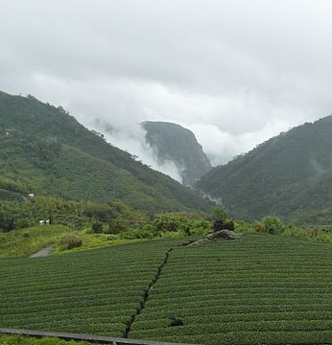
High Mountain Oolong
(Gao Shan)
Grown at altitudes of 1,000 meters or above.
Grows slowly due to the thin air in high altitudes
Low oxidation of around 30%
Relatively low yearly yield.
Types of Taiwanese High Mountain Oolong
Lishan
Alishan
Shanlixi
Dayuling

Slide 15
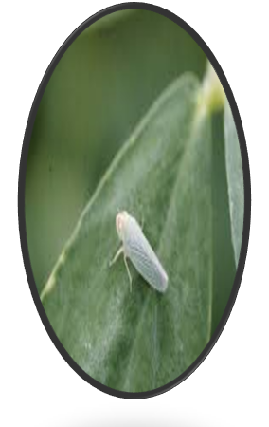
Bug Bitten Teas
Bug bitten teas are a specialty of Taiwan​
They are created by allowing small green leafhoppers, known as a tea jassid, technically a jacobiasca formosana, to attack the tea plants prior to harvest. ​
When bitten by the jassid, the tea plants release specific volatile aromatic compounds which repel the bugs, but to the human palate are surprisingly reminiscent of honey. ​
Examples of bug bitten teas​
Dong Fang Mei Ren aka Oriental Beauty​
Gui Fei aka Royal Concubine Oolong​
Mi Xiang aka Honey-Aroma​

Slide 16
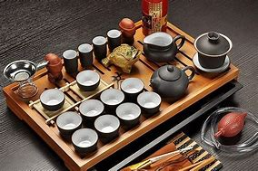
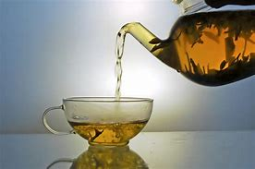
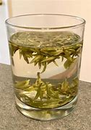
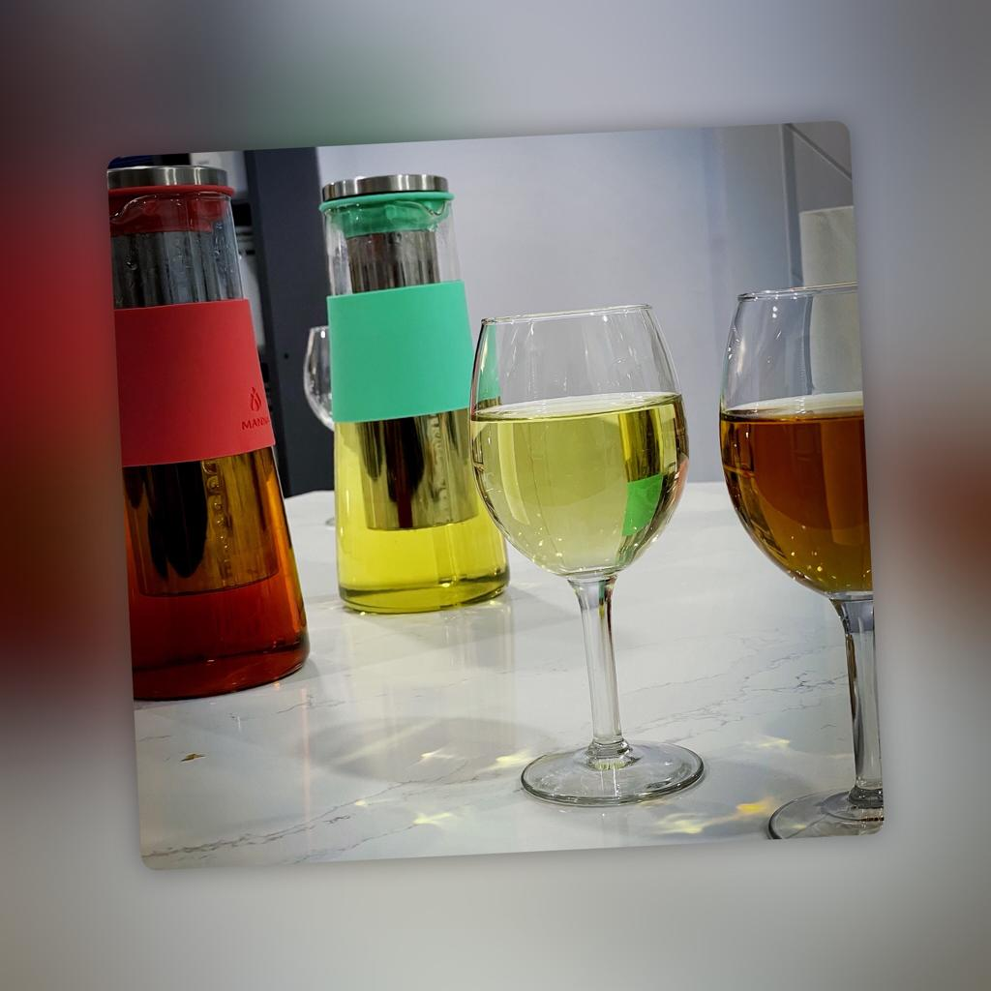
TEA BREWING STYLES
Gongfu Cha
Western Style
Grandpa Style
Cold Brew
Gong fu cha is the traditional Chinese tea ceremony using tea pot or gaiwan..
Concentrated amounts of tea leaf brew in small vessels for a short period. Depending on the tea, the same tea leaves will usually be re-steeped many times.
Western style is perhaps the easiest method of preparing tea.
This tea brewing method requires just one big teapot, unlike the many tea utensils, as are necessary for gong fu brewing.
When brewing tea grandpa style, instead of using a gaiwan or teapot for the tea, we brew it in a big cup. Without the use of any strainers or teabags.
The tea leaves are put directly into the cup and covered with hot water. Having the perfect leaf ratio or water temperature is not at all crucial.
Cold-brewing requires us to pour cold water over tea leaves and leave it in the fridge for several hours to steep. This method of preparing tea requires the most patience. However, we guarantee it is worth it, especially when the temperature starts rising.

