Slide 1
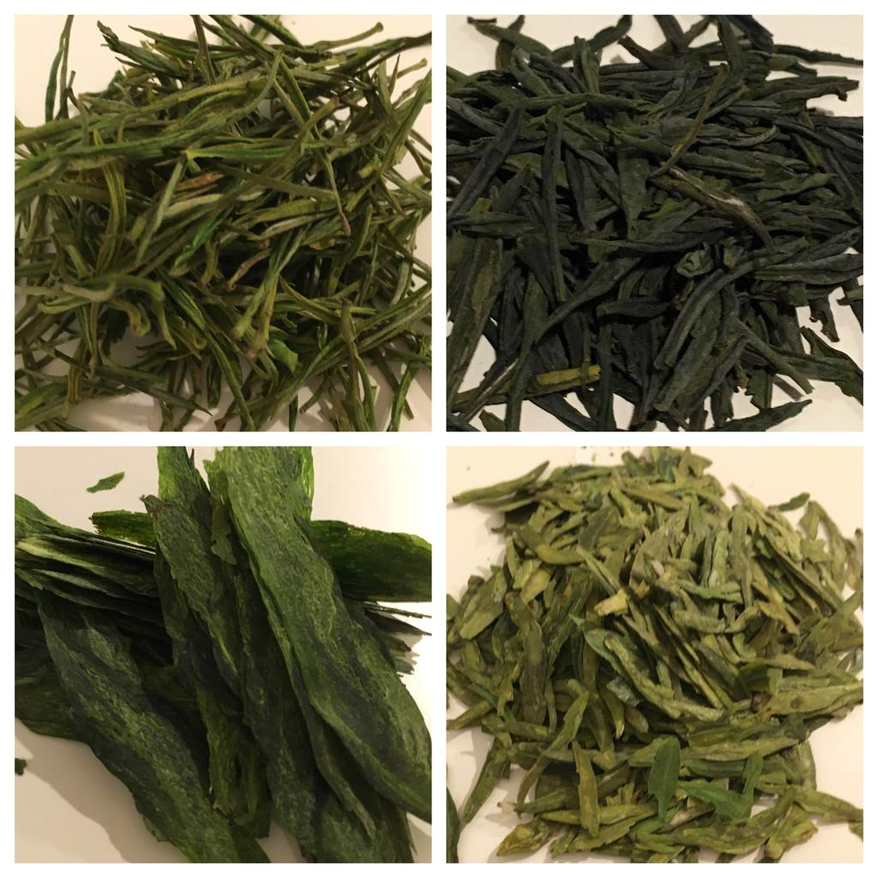
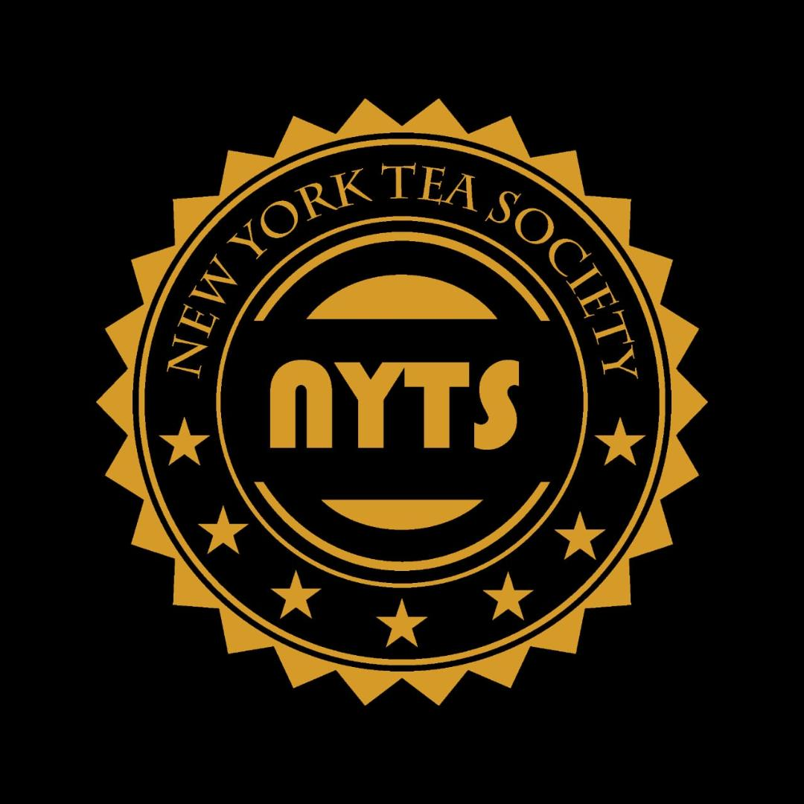
Chinese Green Teas
Presented By: New York Tea Society

Slide 2
Chinese Green Tea Varieties
Official Name Western Name Pinyin Chinese Simplified
Long Jing Dragon Well lóngjǐng 龙井
Bi Luo Chun Green Snail Spring bìluóchūn 碧螺春
Lu’An Gua Pian Melon Seed liù ān guāpiàn 六安瓜片
Anji Bai Cha Anji White ānjí báichá 安吉白茶
Huang Shan Mao Feng Yellow Furry Peak huángshān máo fēng 黄山毛峰
Xin Yang Mao Jian Xin Yang Downy peak xìnyáng máojiān 信阳毛尖
Meng Ding Gan Lu Meng Ding Sweet Dew méng dǐng gānlù 蒙顶甘露
En Shi Yu Lu En Shi Jade Dew ēnshī yùlù 恩施玉露
Anhua Song Zhen Song Zhen Needle ān huà sōngzhēn 安化松针
Hui Ming Cha Purple Shoots huì míng chá 惠明茶Gu
Zhu Zi Sun Purple Bamboo Shoot gù zhǔ zǐ sǔn 顾渚紫笋
Ping Shui Zhu Cha Gunpowder píngshuǐ zhū chá 平水珠茶
Jing Shan Cha Jing Mountain Tea jīng shānchá 京山茶
Nan'an Shi Ting Lu Stone Pavillion Green nán'ān shí tíng lǜ 南安石亭绿
Zhu Ye Qing Bamboo Leaf Green zhúyèqīng 竹叶青
Yong Xi Huo Qing Yong Xi Green Fire yǒng xī huǒ qīng 涌溪火青
Xiu Ning Song Luo Loose Radish xiū níng sōng luó 休宁松萝
Wang Hai Cha Sea of Hope wànghǎi chá 望海茶
Du Yun Mao Jian Duyun Tippy dū yún máojiān 都匀毛尖
Gui Ping Xi Shan Cha Gui Ping West Mountain tea guìpíng xīshān chá 桂平西山茶
Lao Zhu Da Fang Old Bamboo Generous lǎo zhú dàfāng 老竹大方
Nan Jing Yu Hua Cha Rain Flower tea nánjīng yǔ huāchá 南京雨花茶
Tai Ping Hou Kui Monkey King tàipíng hóu kuí 太平猴魁
Kai Hua Long Ding Kai Hua Dragon's Pick kāihuà lóng dǐng 开化龙顶
Lu Shan Yun Wu Lushan Misty Clouds lúshān yúnwù 庐山云雾
Jiang Shan Lu Mu Dan Jiang Mountain Green Peony jiāngshān lǜ mǔdān 江山绿牡丹
Gao Qiao Yin Feng Silver Peak gāo qiáo yín fēng 高桥银峰

Slide 3
Chinese Green Tea Varieties
Official Name Western Name Pinyin Chinese Simplified
Shu Cheng Lan Hua Shu Cheng Orchid shū chéng lánhuā 舒城兰花
Wu Xi Hao Cha Wu Xi Downy tea wúxī háo chá 无锡毫茶
Tian Mu Qing Ding Heaven's Eye Green Peak tiānmù qīng dǐng 天目青顶
Gu Zhang Mao Jian Gu Zhang Downy Tips gǔ zhàng máojiān 古丈毛尖
Yong Chuan Xiu Ya Yong Chuang Premium Bud yǒngchuān xiù yá 永川秀芽
Pan'an Yun Feng Pan An Cloud Peak pán ān yún fēng 盘安云峰
Pu Tuo Fo Cha Buddha tea pǔ tuó fú chá 普陀佛茶
Song Yang Yin Hou Silver Monkey sōng yáng yín hóu 松阳银猴
Pu Bu Xian Ming Immortal Waterfall Buds pùbù xiān míng 瀑布仙茗
Qian Dao Yu Ye Thousand Islands Jade Leaf qiāndǎo yù yè 千岛玉叶
San Bei Xiang 3 Cup Fragrance sān bēi xiāng 三杯香
Jing Ting Lu Xue Green Snow jìng tíng lǜ xuě 敬亭绿雪
Xue Shui Yun Lu Snow Water Clouds xuě shuǐ yún lǜ 雪水云绿
Lin Hai Pan Hao Curly Buds, Curly Tips línhǎi pán háo 临海蟠毫
Pu Jiang Chun Hao Pu Jiang Spring Buds pǔjiāng chūn háo 浦江春毫
Yang Yan Gou Qing Sheep Rock Green Hooks yáng yán gōu qīng 羊岩勾青
Lu Jian Cha Green Swords lǜ jiàn chá 绿剑茶
Zi Yang Mao Jian Purple Sun Downy Tips zǐyáng máojiān 紫阳毛尖
Dian Qing Yunnan Green tea diān qīng 滇青
Wu Yang Chun Yu Spring Rain wǔ yángchūnyǔ 武阳春雨
Wu Zi Xian Hao Wu Zi Heavenly Buds wǔ zi xiān háo 午子仙毫
Lu Ming Wu Cha Lu Ming Fog Tea Lù míng wù chá 鹿鸣雾茶
Dong Bai Chun Ya Eastern White Spring Buds dōng báichūnyá 东白春芽
Jian De Bao Ya Jian De Bud tea jiàn dé bāo chá 建德苞茶
Mao Shan Chang Qing Mao Shan Evergreen máoshān cháng qīng 茅山长青
Xiao Bu Yan Cha Xiao Bu Rock tea xiǎo bù yán chá 小布岩茶

Slide 4
Chinese Green Tea Varieties
Official Name Western Name Pinyin Chinese Simplified
Xian Yao Yun Wu Heavenly Jade Misty Fog xiān yáo yǐn wù 仙瑶隐雾
Feng Yang Chun Phoenix Spring Sun fèng yáng chūn 凤阳春
Nu'er Huan Daughter's Ring nǚ'ér huán 女儿环
Cheng Tian Xue Long Snow Dragon chéng tiān xuě lóng 承天雪龙
Wu Zhou Ju Yan Wu Zhou Rock Lift wù zhōu jǔ yán 婺州举岩
Yang Dang Mao Feng Yang Dang Furry Peak yàndàng máo fēng 雁荡毛峰
Wang Fu Yin Hao Wang Fu Silver Needle wàng fǔ yín háo 望府银毫
Heng Wen Xi Xiu Fine Beauty héng wén xì xiù 横纹细秀
Fu Lai Chun Floating Spring fú láichūn 浮来春
Wu Dong Cha Misty Cave tea, wù dòng chá 雾洞茶
Da Fo Long Jing Da Fu Dragon Well dàfú lóngjǐng 大佛龙井
Mei Cha Eyebrow green tea méi chá 眉茶
Xue Qing Snow Spring tea xuěqīng chá 雪青茶
Cai Hua Mao Jian Flower Picking Downy Buds cǎihuā máojiān 采花毛尖

Slide 5
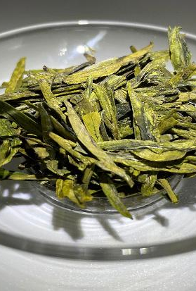
Longjing aka – dragonwell
Imperial Tribute Tea
Originally produced in the West lake region of Zhejiang province
Shaped and dried by hand using a heated pan
Tea makers use their flat hands to move the bud sets around the pan to produce the signature longjing shape with each tea bud flat, shiny and yellow-green.
The brew has a distinct roasted bean and orchid-like flavor, which local Hangzhou people call Lan Hua Dou Xiang.
The legend of Long Jing says that the Emperor visited the Hu Gong Temple in West Lake one day and was presented with a bowl of the tea. He was so impressed by the delicious taste and aroma that he gave imperial status to the 18 tea bushes growing in front of the temple.

Slide 6
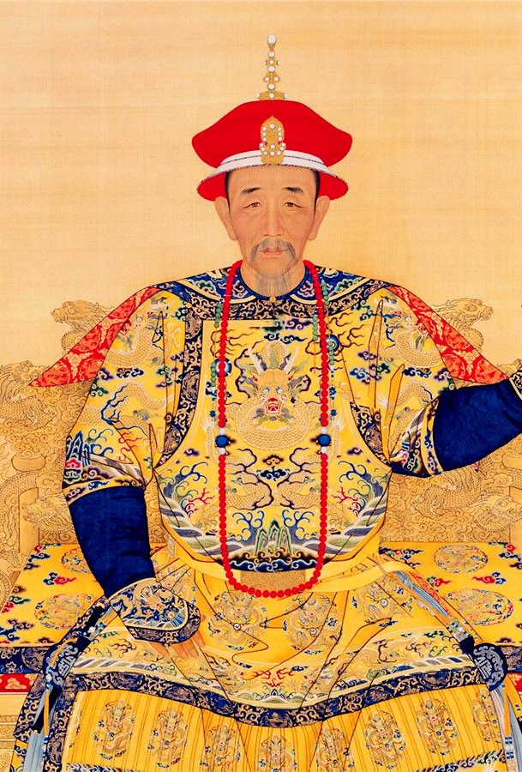
Longjing - The Origin Story
Imperial Status
The Qianlong Emperor, visited Hu Gong Temple under the Lion Peak Mountain (Shi Feng Shan) in West Lake and was presented with a cup of Longjing tea.
In front of the Hu Gong Temple were 18 tea bushes.
The Qianlong Emperor was so impressed by the Longjing tea produced here that he conferred these 18 tea bushes special imperial status.
The trees are still living
The Shape
While the Qianlong Emperor was visiting the temple, he was watching the ladies picking the tea.
He was so enamored with their movements that he decided to try picking tea himself.
While picking tea he received a message that his mother, Empress Dowager Chongqing, was ill and wished his immediate return to Beijing.
He shoved the leaves he had picked into his sleeve and immediately left for Beijing.
Upon his return he immediately went to visit his mother.
She noticed the smell of the leaves coming from his sleeves and he immediately had it brewed for her.
It is said that the shape of Longjing Tea was designed to mimic the appearance of the flattened leaves that the emperor brewed for his mother
The Name
Longjing, which literally translates as "dragon well," is said to have named after a well that contains relatively dense water.
After rain, the lighter rainwater floating on its surface sometimes exhibits a sinuous and twisting boundary with the well water, which is supposed to resemble the movement of a Chinese dragon.

Slide 7
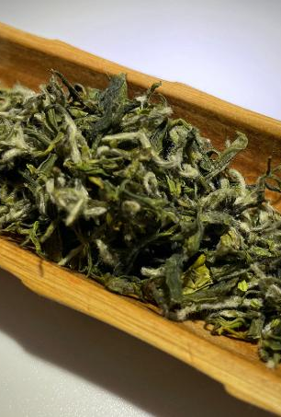
BILUOCHUN
The name Biluochun literally means "green snail spring".
It was an Imperial Tribute Tea to the Tang Dynasty and is still on the list of the Chinese Famous Top 10 Teas
Originally it was produced in the Dongting Mountains near Lake Tai in Suzhou, Jiangsu Province.
One bud and a leaf
Hand-picked and shaped
Harvested in late March to Early April.
One of the earliest harvested green teas of the spring
Traditionally brewed by placing the leaves into water, as opposed to pouring water over the leaves. The leaves slowly float to the bottom like falling snowflakes.

Slide 8
BILUOCHUN – Dongting Mountain Region
The Dongting mountain region is located near Lake Tai in Suzhou, Jiangsu Province.
Dongting Mountain is an old tea producing area dating back to the Tang Dynasty (619-907).
Bi Luo Chun became popular during the Ming Dynasty (1368-1644)
It became a tribute tea in the Qing Dynasty (1644-1911), in the 38th year of the Kangxi Emperor’s reign (1661-1772).
The Dongting region features lakes and mountains.
Water evaporates from the lakes, keeping the mountains shrouded in clouds and mist.
These conditions are perfect for Biluochun tea.
One secret to the unique aroma and taste are fruit trees.
Growers plant apricot, plum and peach trees between the tea bushes, so that the tea leaves can absorb some of the fragrance from the fruit trees.

Slide 9
BILUOCHUN – The Name
The name Biluochun describes the teas most important characteristics:
BI - the deep green color
LUO - the curled dried tea shape like a snail
CHUN - harvested during the early spring (chun), resulting in its white feathery appearance.
Its original name is Xia Sha Ren Xiang , meaning Scary Fragrance.
Legend tells of its discovery by a tea picker who ran out of space in her basket and put the tea between her breasts instead.
The tea, warmed by her body heat, emitted a strong aroma that surprised the girl.
The Kangxi Emperor visited Lake Tai in the 38th year of his rule.
He enjoyed the tea very much and decided to give the tea a more elegant name, "Green Snail Spring".

Slide 10
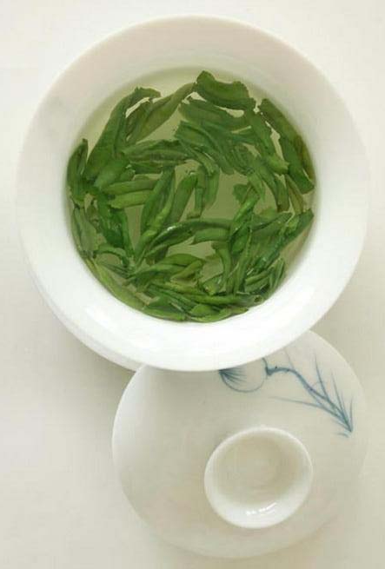
Lu’An Guapian
A green tea from Lu'an, Anhui Province.
Named for its tightly rolled seed-like processed leaves, which are flat and resemble a melon seed.
Lu'an Guapian does not contains any buds or stems.
It is grown in the Dabie Mountains in Anhui Province
A mountainous area with a misty, humid, cloudy climate which contributes to Guapian Tea’s superior quality.
It is harvested in mid-April, allowing the buds to open up
The first documented evidence of Lu'an Guapian dates back to the Tang Dynasty (618-907) when records were found in Lu Yu's Cha Jing
Lu’an Guapian was designated as a tribute tea during the Qing Dynasty (1636-1911).
In 1971, Secretary of State Henry Kissinger was gifted with this exquisite green drink during his first visit to China.
In 2007, former Chinese President Hu Jintao gave Lu'an Guapian as a State gift to Russian President Vladimir Putin during his visit to Russia.

Slide 11
Mythical origin story of Lu’An Guapian
In China’s ancient past, a small village was constantly ravaged by a giant monster that lived in a cave in a mountain near the village.
The monster, when hungry, would race down the mountain and attack the village.
It would lay waste to the village and devour the local people and their livestock to feed its voracious appetite.
The villagers would rebuild and about a month later the monster would return.
The Bodhisattva Guanyin (Iron Goddess of Mercy!) took pity on the poor people and planted Lu’An Guapian trees in front of the village.
The next time the monster came to devour the locals, he was stopped by the wonderful smell emanating from the trees and was pacified.
From that day on, the monster no longer bothered the village.

Slide 12
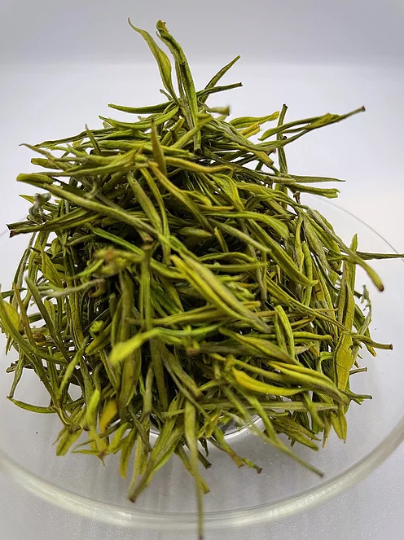
Anji Bai Cha
Anji – Anji County, Huzhou Prefecture, Zhejiang Province, China
Bai – White
Cha – Tea
Although Anji Bai Cha is called white tea, it is not a white tea, it is a green tea
The name is derived from the pale green color of the baiye yihao cultivar leaves used to produced Anji Bai Cha
It is a specialty of Anji County and is a national geographical indication product of China.

Slide 13
Anji Bai Cha - History
Anji Bai Cha has a history of nearly a thousand years.
Bai Cha was also introduced in Lu Yu’s The Classic of Tea written in the Tang Dynasty (618-907).
In the Northern Song Dynasty (960-1127) Emperor Huizhong wrote the Da Guan Cha Lun or The Treatise on Teas, as it is known in the west, which included records about Anji Bai Cha.
Emperor Huizong was a great connoisseur of tea, with masterful skill in the art of tea ceremony. He often engaged in tea tasting and tea competitions with his subordinates at the Song imperial court.
Emperor Huizong's favorite was Anji Bai Cha.
In 1930, an Anji tea farmer found dozens of wild Bai Cha trees on the mountains.
At that time, wild tea trees were not used in the production of green tea.
In 1982, during the general survey of agricultural resources in Zhejiang Province, Anji Bai Cha was rediscovered.
Although the formal production history of Anji Bai Cha is not long, it quickly became famous due to its unique style and high quality.
In 2004, Anji Bai Cha became a national geographical indication protection product of China.
On November 15, 2019, Anji Bai Cha was selected into the Chinese Agricultural Brand Directory.

Slide 14
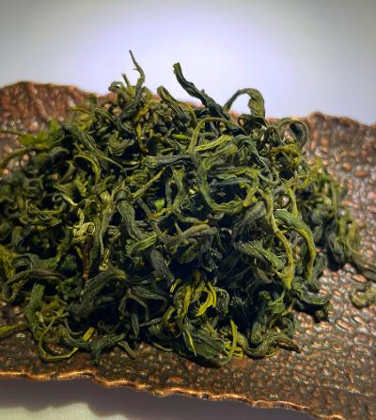
Xinyang Maojian
Located in southern Henan Province, Xinyang has a mild climate and excellent for Maojian tea production.
Many high mountains, surround the location to support environmental humidification and moisture, including Mt. Cheyun, Mt. Jiyun, and Mt. Tianyun.
Xinyang is abundant with forests, clouds, rainfall, and large temperature difference between day and night.
These geographical advantages help keep Xinyang's soil healthy and fertile, while trees more efficiently absorb the elements needed to produce high quality tea.
The harvest season for Maojian tea is in spring and fall.
The best quality tea comes from leaves that are harvested in mid-April.
Because the leaves are rare and fresh, the price is two or three times higher than tea produced after this season.
In general, the approximate ratio of fresh leaves to produced tea is 50,000 buds per 500 grams.
In 1987, archaeologists in the Xinyang area discovered ancient tea in excavated tomb sites and determined that the tea was made in 875 BCE.

Slide 15
The mythical origin story of Xinyang Maojian
A long time ago in China, there was a strange disease in Xinyang which afflicted all the local people, that could not be cured by medicine at that time.
A young village girl searched for help to cure her village.
The young girl came upon an old man, who told her that if she could cross 99 mountains to find a very special tree and return to her village with the leaves in 10 days, her village would be cured.
The girl took up her crusade to save her fellow villagers and crossed the 99 mountains and found the special tree.
However, when she found it, she had no energy to walk the long distance back to her village.
The guardian of the special tree took pity on the girl and turned her into a bird, which carried the tea leaves and seeds of that special tree home to her village.
The villagers were all cured by the leaves and the local villagers began to plant this tree, which became a large tea garden.

Slide 16
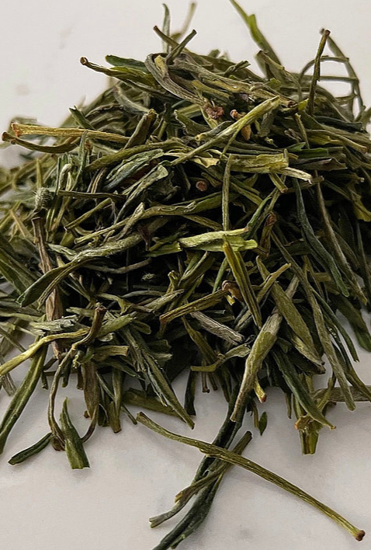
Huangshan Maofeng
An Imperial Tribute Tea
Mao Feng translates to "Fur Peak".
It has small white hairs which cover the leaves.
The shape of the processed leaves resembles the peak of a mountain.
Only the new tea buds and the leaf next to the bud are picked.
The tea has a roasted aroma and a light floral overtone.
The tea is grown near Huangshan (Yellow Mountain)
Fuxi（富溪）is the name of the town in Huangshan where tea merchant Xie Zhengan invented Huangshan Maofeng
During the Qing Dynasty, around 1875, Xie Zhengan selected tea buds from Fuxi and started making Huangshan Maofeng.
It was an instant success, and he became the richest man in Huangshan
He went on to own nine tea shops around China.
Fuxi Huangshan Maofeng is still considered to be the best of all the Huangshan Maofeng tea.
It is known to have a more beautiful appearance and unique and lovely taste and flavor than maofeng tea from other regions in Huangshan.

Slide 17
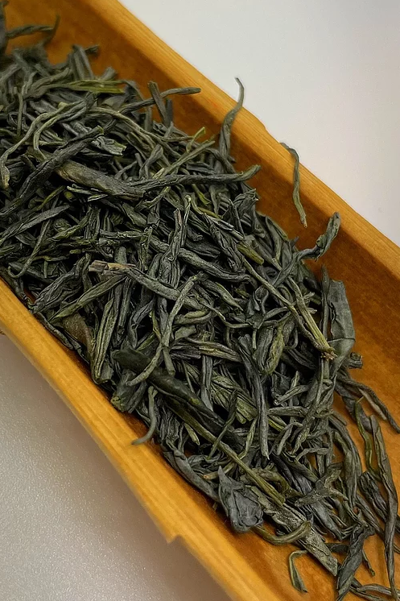
En Shi Yu Lu
A rare China green tea.
En Shi origin teas are well known for the high content of selenium
This tea is made similar to Japanese Gyokuro.
It is not a copy of Japanese Gyokuro but the original Chinese version of this unique steamed tea that was first made in China and later developed into the famous Japanese Gyokuro today

